Slide 1
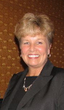
Cynthia Marco Scanlon
President
National Career Development Association

Slide 2
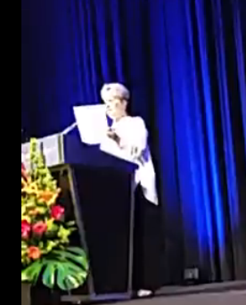

Slide 3
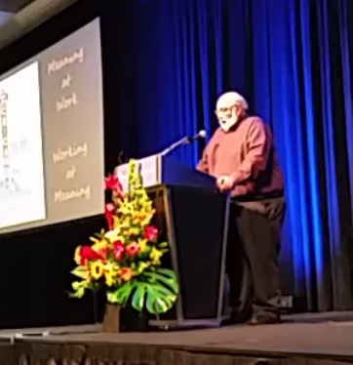

Slide 4

Meaning
at
Work
Working
at
Meaning

Slide 5


Slide 6


Slide 7
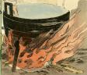

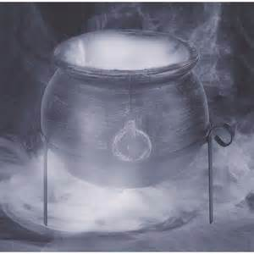

Slide 8


Slide 9


Slide 10





Slide 12
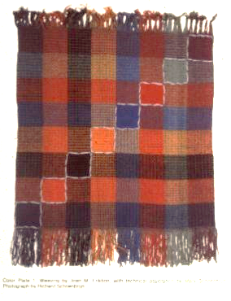
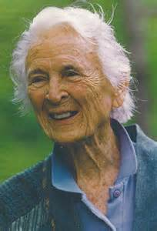
Joan Erikson’s
8 Stages of Life
Tapestry

Slide 13


Slide 14
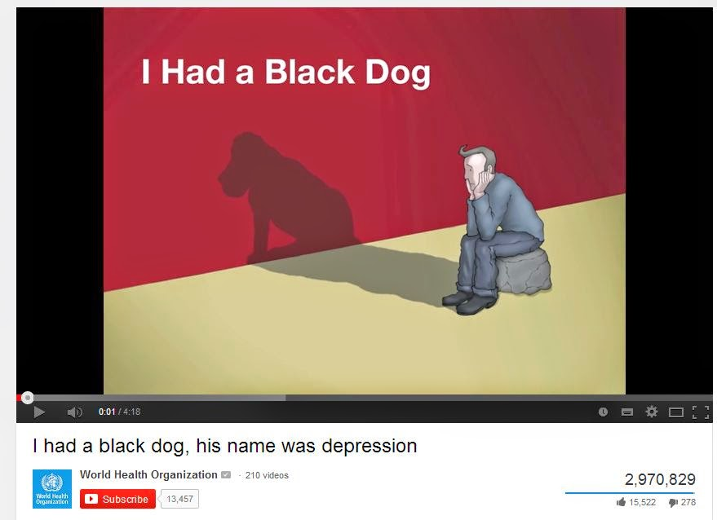
His name was depression

Slide 15
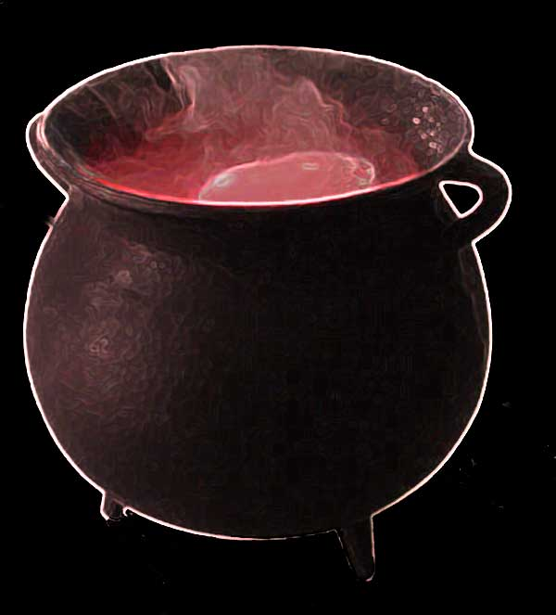

Slide 17


Slide 18
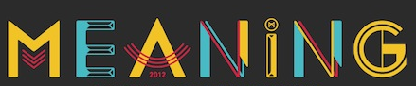
Career
Contains and
Carries
Meaning
CARRIER

Slide 19


Slide 20


Slide 21
MEANING
Career
Story

Slide 22

This is how the story of career transitions is told in myth.
I would like to tell the same story in the language of modern career theory and practice.

Slide 23

The Woman is a Social Actor
As toddlers, we begin to learn our place in the world and develop habits that become our personality traits.
Co-construct the first layer of self,
namely, the social actor.

Slide 24
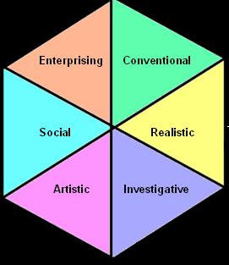
Guiding the Social Actor
Vocational Guidance
Vocational Guidance is a Counseling Service for Social Actors.
RIASEC characterizes an actor’s traits.
Then matches the traits to occupational
personality types.
Our weaver matches the Artistic-Realistic type.

Slide 25

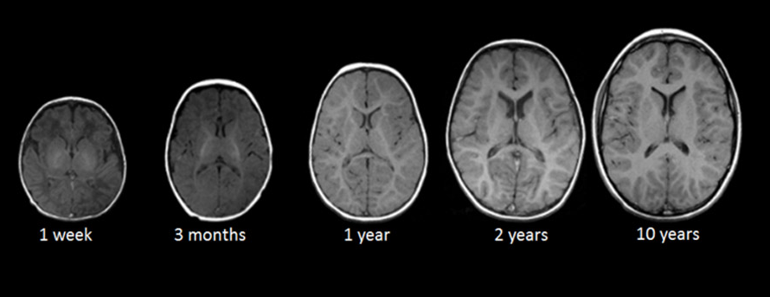
Having formed a self as a social actor, the child moves out into the world.
By middle childhood, the brain has matured sufficiently to support a second layer of self, the motivated agent.

Slide 26

Motivated agent designs tapestry of interests and goals
Agentic self is about goals not
traits.
Agent takes deliberate control
of daily life
Attention becomes more selective, adaptable, and planful.

Slide 27
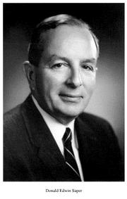



Developing the Motivated Agent
Career Education and Coaching
CONTENT: Work values, vocational interests, occupational abilities
PROCESS: Self-evaluating, exploring, deciding, planning, solving problems
Super’s
Career Maturity
Gati’s
Decision Making
Betz’s
Self-Efficacy
Blustein’s
Volition

Slide 28
Social Actor vs. Motivated Agent
Traits are how you act today.
Goals are what you want for tomorrow.
Correlation between actor’s traits and agent’s goals is quite modest.
Interest inventory’s have a 45% hit rate.

Slide 29
Third Layer of Self is Author
Narrate a Career Story
Autobiographical authors make meaning by narrating stories that describe and define themselves as social actors motivated to pursue goals across time.

Slide 30

People construct stories to make meaning and pursue purpose.
Narratives organize self-expression.

Slide 31
Subjective career is a story a person tells about her working life to make meaning that explains why she does what she does.

Slide 32
Co-construct the Autobiographical Author
Life Designing Dialogues
In making a career transition, clients must re-story or reconstruct their career narrative.
The cauldron of reflection and dialogue is the womb of career reconstruction.

Slide 33
Social Cognitive Neuroscience
When we are in stable jobs and things go as we are accustomed our judgements go along fairly automatically without becoming the focus of self-conscious attention.
Routine transitions, however, require attention, effort, and reasoning of paradigmatic thought.

Slide 34
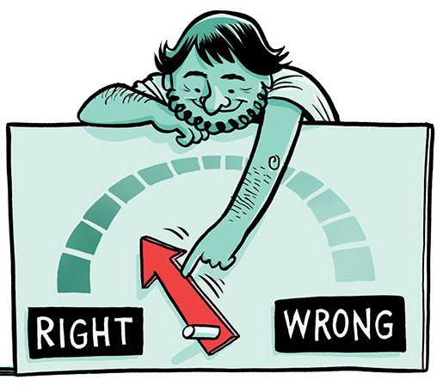
Paradigmatic Thought
Logic, Scientific reasoning, Empirical evidence
that explain how the world works.

Slide 35
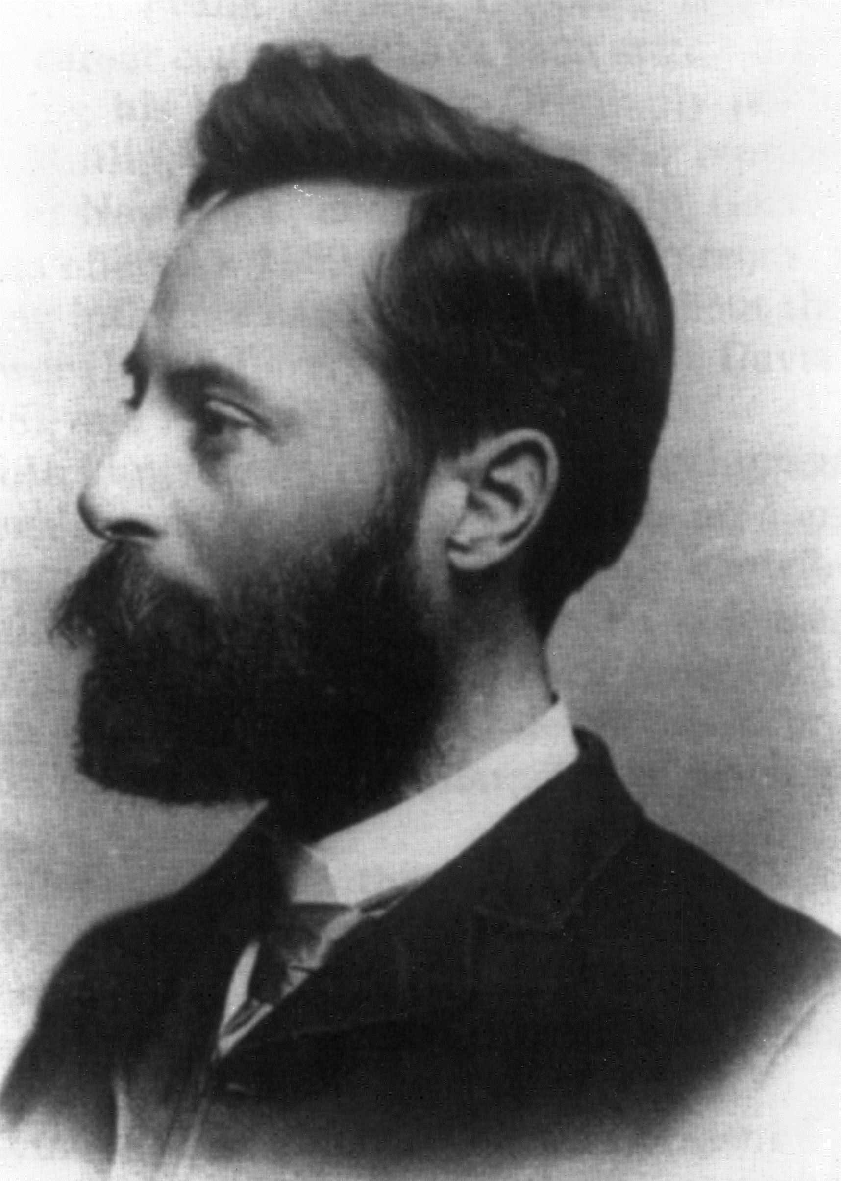
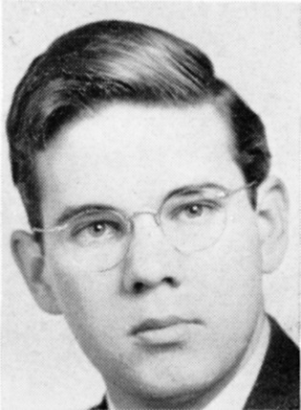

Match Making
Parsons
Holland
Paradigmatic or analytical thinking transforms the transition problem into a similarity problem by estimating the match between the antecedent and the consequent.
The overall structure of the question can be formed as “If someone has background x, is she then more likely to be a or to be b?”

Slide 36
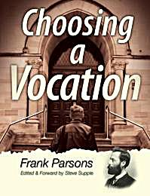
“Once upon a time, careers work was straightforward, modern, and scientific. In Choosing a Vocation, Frank Parsons was clear that he was harnessing the power of science and contributing to the development of a more rational and efficient society.”
(Hooley & Rawlinson, 2011)

Slide 37
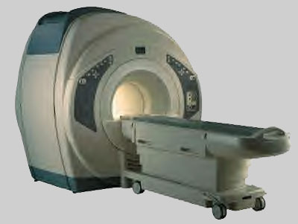
Parsons might be pleased to see that now science can map the brain solving career problems.
MRI
measures brain activity by detecting changes in blood flow in different areas of the brain associated with particular mental tasks.

Slide 38
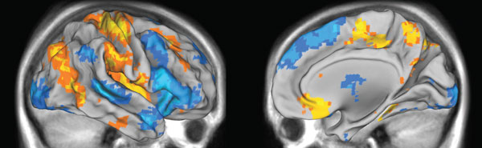
Blue associated with focused attention and analytic reasoning
Rational

Slide 39
First–order change
Guide clients to make changes and choices,
form commitments achieve adjustment restore stability
Change occurs within the current perspective

Slide 40
Social Cognitive Neuroscience
When problem solving fails, a second system of thought is needed to guide behavior, especially in novel situations.

Slide 41
Social Cognitive Neuroscience
Individuals make the narrative turn
to thinking and reflect in
the cauldron of self-consciousness .

Slide 42
Second-order change
Reflection and dialogues prompt a new perspective
Transformative change in thoughts, feelings, beliefs
Affects inner life. Reflection is inherently emotional because we only think deeply about things we care about.

Slide 43
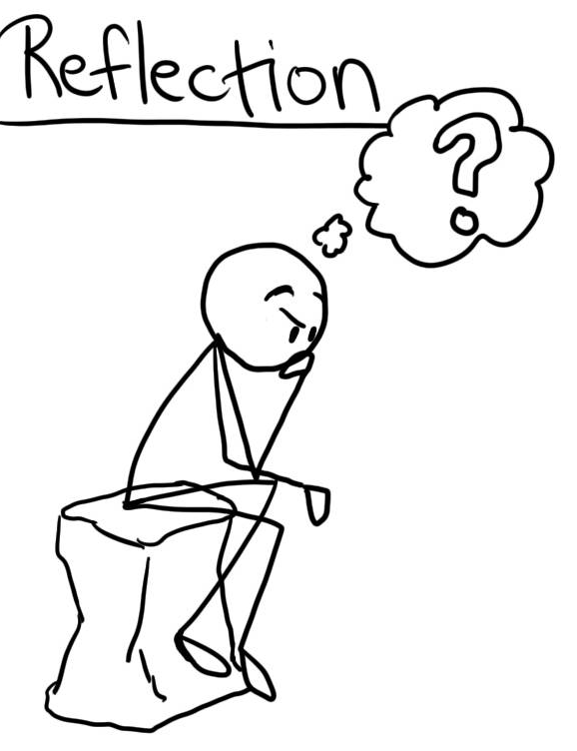
Reflection extracts
intentions when
analysis fails.
“the unthought known”
Reflection shapes meaning in life.

Slide 44
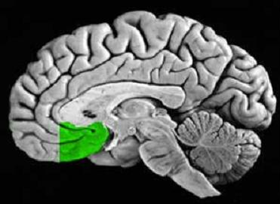
Narrative thought is supported by the ventromedial prefrontal cortex which during late adolescence and emerging adulthood develops rapidly and increases activity.

Slide 45
It is the area of the brain that helps create a sense of purpose in life and has a key role in constructing one's self.

Slide 46
Paradigmatic thinking representations are distributed and overlapping.
Narrative thinking representations are sparse and separated.
BRAIN DURING COACHING
Paradigmatic
Narrative
Problem-solving
Goal setting
Overcome barriers
Dreams
Possibilities
Visioning
Future
Blue:
attention & problem solving
Yellow:
perspective & visioning

Slide 47
Two Systems of Thinking
Reasoning
veracity of logical decisions
Narrating
validity of proposals for continuing the story

Slide 48
Narrative Truth
Validity
Narrative truth may differ from historical fact.
It can fictionalize the past to preserve
continuity and coherence during transitions.
This enables people to meet change with
fidelity and flexibility.

Slide 49
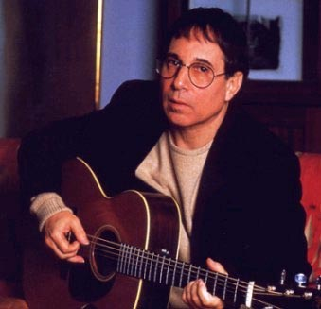
Paul Simon
Nothing is different but everything has changed.
After changes we are more less the same.

Slide 50
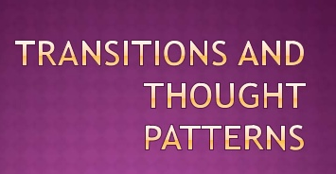
Reasoning and narrating are the two thought processes used to make transitions.
The best counseling uses both and moves quickly between paradigmatic agency and narrative relexivity.

Slide 51
Paradigmatic Matching
Vocational guidance and career coaching emphasize resemblance to make matches and (true) reasoning to make realistic decisions.
Paradigmatic thought helps social actors to evaluate their performance, explore the world, and move to fitting environments.
Pursue job satisfaction and happiness through rewards for social performance.

Slide 52
Narrative Meaning
Career construction discourse & life designing dialogues emphasize
reflection to make meaning and uniqueness to shape identity.
Narrative thought helps the autobiographical author to move to a new perspective, envision possible futures, and trust intuition.
Pursue well-being, does not imply happy, but simply how well one is faring as a person.

Slide 53
Match Making for Resemblance
Paradigmatic thought uses social & affective generalities.
Meaning Making for Uniqueness
Narrative thought processes things uniquely depending
on the context, especially in situations that are
exceptions to the rules.

Slide 54
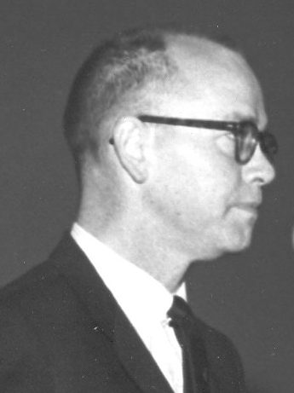
Career imposes meaning on vocational behavior.
David Tiedeman

Slide 55
Working
at
Meaning
Meaning
at
Work
How do people use narrative thinking to construct a career story that imposes meaning on work?

Slide 56
During the odyssey years (18-30),
narrative thinking makes career meaning
Unify different interests and commitments
Articulate dominant themes in the career story
Bring career story to point of meaning & purpose
Use pursuit of purpose to weigh alternatives
Make integrative choices

Slide 57
Life Designing Dialogues
Move Clients to Make Meaning
Conversations that reflect on stories to elaborate meaning and fuel emotions.
Not a description of behavior or traits but exploration of inner experience in greater depth resulting in richer story.

Slide 58

Life Designing Dialogues
Help clients grasp a golden thread to explain how they came to be and where they are going.

Slide 59
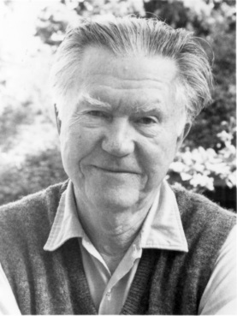
From The Thread That You Follow
(1993)
The Way It Is
William Stafford
There's a thread you follow. It goes among
things that change. But it doesn't change.
People wonder about what you are pursuing.
You have to explain about the thread.
But it is hard for others to see.
While you hold it you can't get lost.
Tragedies happen; people get hurt
or die; and you suffer and get old.
Nothing you do can stop time's unfolding.
You don't ever let go of that thread.

Slide 60
Life Designing Dialogues
Construct a self-defining story with coherence and continuity by selectively reconstructing the past in such a way that it seems to have been rehearsal for what comes next.

Slide 61
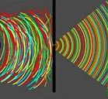

Coherence Organizes Meanings
Continuity Pursues Purpose

Slide 62
In making new meaning, the
person touches an intrinsic
impulse and perceives, as if by
magic, some new perspective
and richer understanding that
strengths self-efficacy and
raises the sense of possibility.

Slide 63
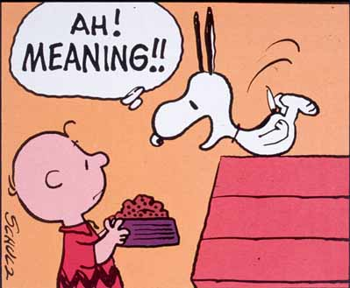
Moments of meaning making feel transcendent.
An awareness of enlarged possibilities.
The senses are amplified.
Fire is added to life.
There is a thrust of energy.

Slide 64


Power of the Pause
  Stories provide a space in which clients can step back from small stories about work-life to reflect on the large narrative of career.
  Storytelling allows people to consider the current work-life transition within an ongoing career narrative.

Slide 65
Life Designing
Career construction counselors evoke several small stories and listen for the themes or golden threads that weave a larger story.

Slide 66
Transition Story
A Framing Story to Position Listener for Stories to Come
It describes a disruption or deviation, a gap that needs to be filled, so as to become whole and complete.

Slide 67


Career Indecision is
Hesitation Before Transformation
Deviation or Disruption
ABOUT TO LOSE PLACE
Completing a scene or chapter
Being de-storyed
Falling out of story

Slide 68

STORIES RESOLVE INDECISION and FORM INTENTION
STORIES ACHIEVE MEANING BY EXPLAINING A DEVIATION OR DISRUPTION
MAKE SENSE BY
EXPLAINING A DIFFERENCE
ACCOUNT FOR CHANGE
FROM BEGINNING TO END
Coherence
Coherence
Continuity
Continuity

Slide 69
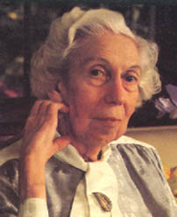
Counselors help clients to hear
and reflect on their own stories to
increase coherence and continuity.
But how do we hear the story?
Friends listen to a story.
Counselors listen for the story.
Eudora Welty

Slide 70

Literary Criticism
scholarly approach to listening for story meaning

Slide 71
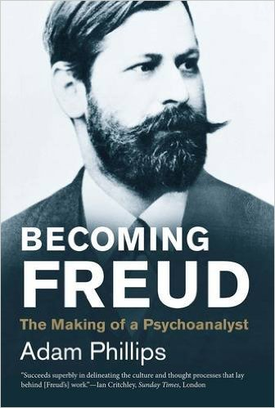
Freud taught us to read differently the stories we tell ourselves about our lives, and about other people’s lives.

Slide 72

Listening for Meaning
Psychoanalytic
Marxist
Feminist
Cultural studies
Reader Response
Structural
Post-structural
Interrogating stories to discern meaning

Slide 73
Career Construction Counseling
CCC has evolved a language pattern for identifying and reflecting on stories as a route to meaning making.
You may develop your own pattern of listening for stories.
There is never a single valid or objective analysis of client stories.

Slide 74


Narrative is a story
Paradigm is a pattern
Narrative Paradigm
is Life Design Pattern
to listen for story
theme and meaning

Slide 75
Narrative Paradigm
Actively master what you passively suffer.

Slide 76

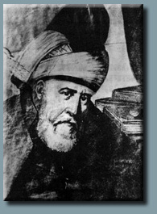
From Wound to Womb
13th Century Persian Poet

Slide 77

Your blessing comes from your wound.
From Wound to Womb
Infusing hope into a wound
makes it a womb.
Native American Shaman

Slide 78
The Pattern
From preoccupation to occupation
From obsession to profession
From tension to intention
From victim to victor
From lemons to lemonade
From despair to repair
From obstacle to opportunity

Slide 79
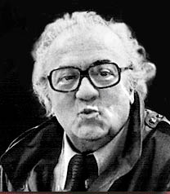
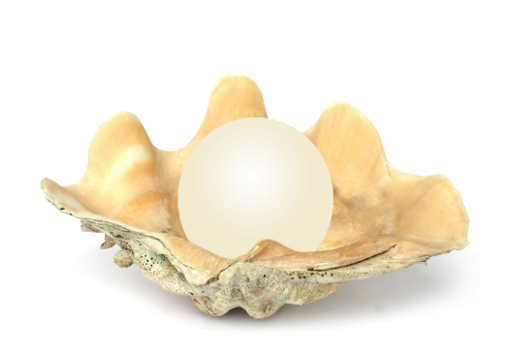
Frederico Fellini
The pearl is the oyster’s autobiography.

Slide 80
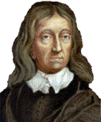
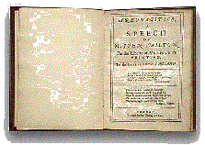

John Milton
Book Two – The Argument
Our torments also may,
in length of time,
become our elements.

Slide 81
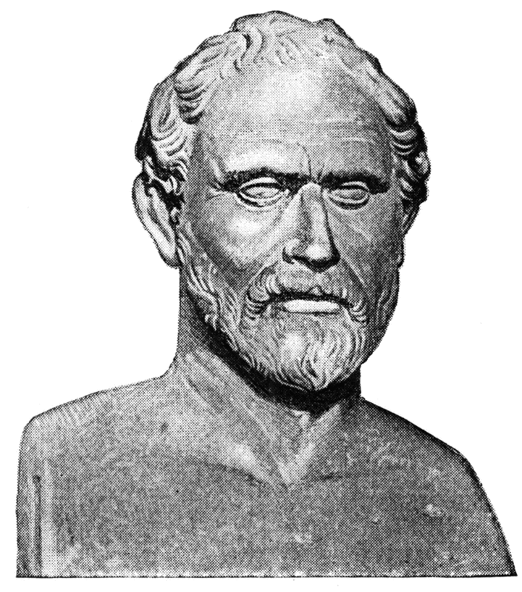
Demosthenes
Every difficulty has an opportunity.
From stuttering to speaking
Look for the opportunity

Slide 82
Moves in Meaning
Fear to courage
Helpless to helpful
Weak to strong
Alone to together
Abused to advocate
Dumb to smart
Small to big
Vicious to virtuous
Different to special
Prove to improve
Obligation to negotiation
Driven to driver
Impossible to I’m Possible

Slide 83
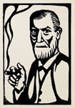
SIGMUND FREUD
Where id was, there ego shall be.

Slide 84
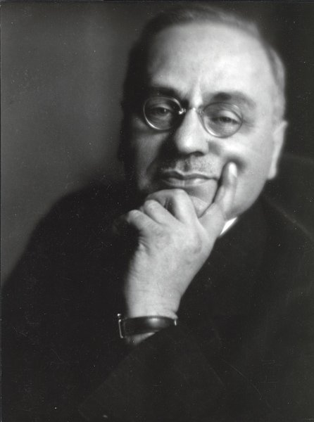
ALFRED ADLER
From a felt negative
to a perceived plus

Slide 85

From
MISERY
To
MEANING

Slide 86

Gold Embedded in Lead
Spirit Imprisoned in Suffering
Meaning arises out of pain.
Contain pain in a vessel.
Pain contained can be transformed.
Boil it, cook it with self-reflection.
Find symbols in your symptoms.
Deeper meaning moves us forward.

Slide 87
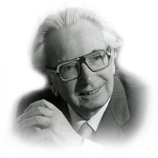
Victor Frankl
From Tragedy to Triumph
Turn your predicament into an achievement.

Slide 88
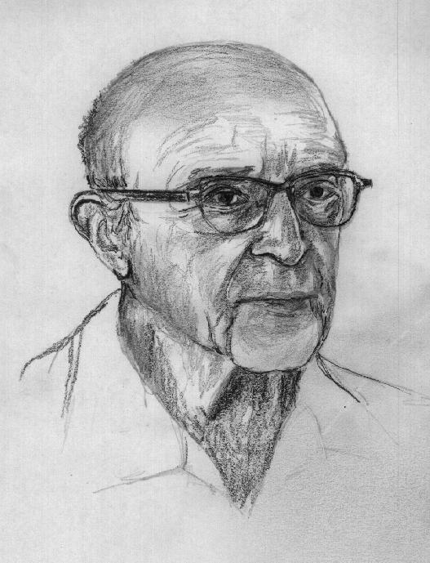
From Incompleteness to Self-realization
From Ignorance to Self-Awareness
Carl Rogers

Slide 89
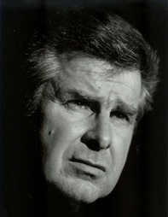
From Blame to Ownership
blame to ownerships
Robert Carkhuff

Slide 90

Narrative Therapy
Re-authoring or re-writing the story involves changing from how the person has been influenced by the problem to how the person has influence on the problem.

Slide 91
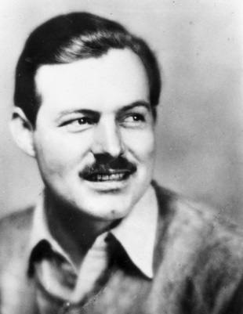
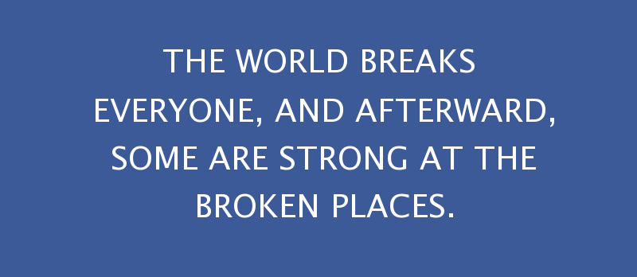
Hemingway’s Credo

Slide 92
Theme of absent parent runs through her books.
She calls it “the absolute true story of my heart.”

Slide 93
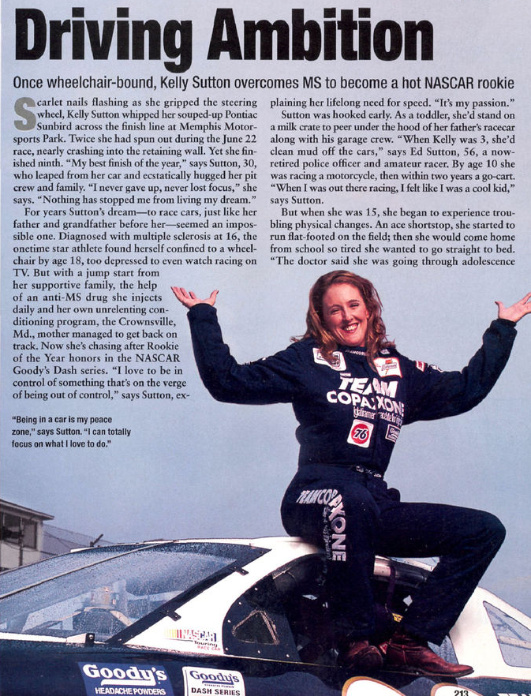

53% of People magazine’s article in 2001-2002 contained an active mastery pattern.

Slide 94

A title I read today in a newspaper – Jean Guichard
“Mes parents sont divorcés:
je suis devenue photographe de mariage. Sans déconner!”
“My parents have divorced: I became a photographer specialized in wedding pictures. Not a joke!”

Slide 95
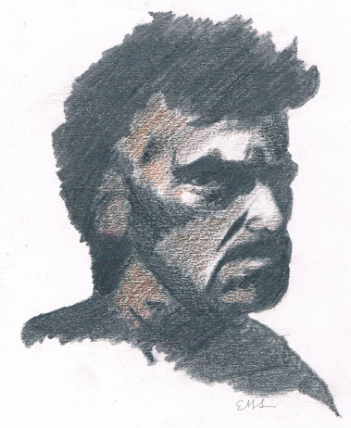

Man is born broken.
He lives by mending.
Eugene O’Neil
The Great God Brown (1926)

Slide 96
What makes the pattern is not just the arc of life from passive to active, it is the repetitive weaving of the tapestry.

Slide 97
SIGMUND FREUD
Repetition compulsion

Slide 98
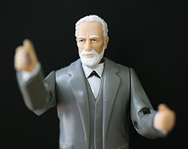
Repetition Compulsion
Relive negative experiences in an effort to undo or master the past
get it out of your system
get used to it
learn to live with it

Slide 99
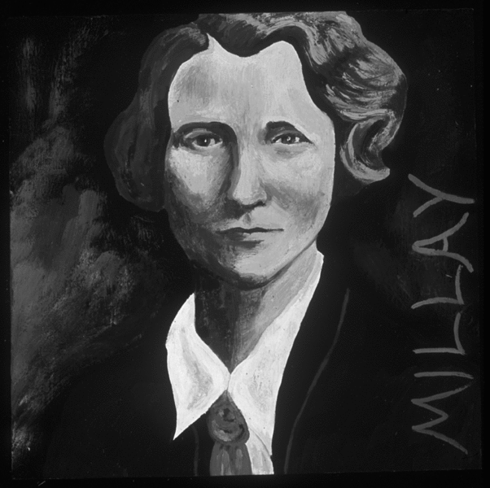
Life isn't one damn thing after another.
It's the same damn thing again and again.
Edna St. Vincent Millay

Slide 100
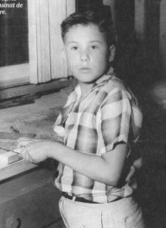
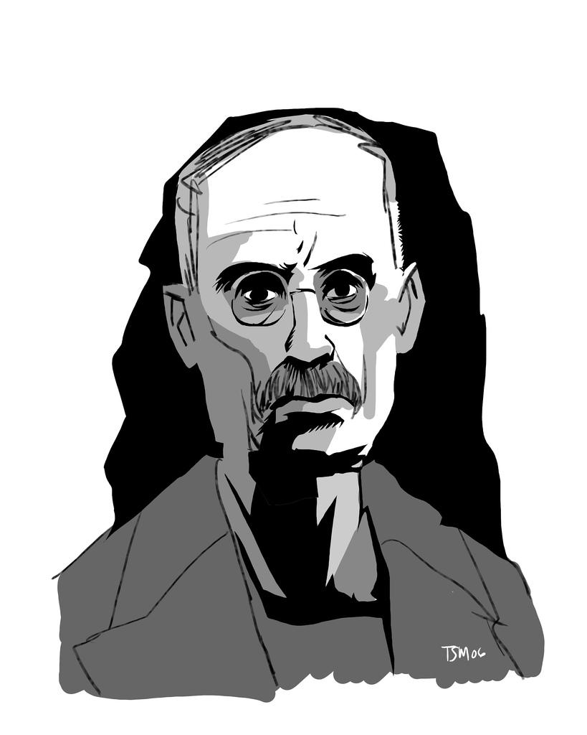
The wound that will not heal
James Ellroy’ mother raped and murdered
when he was 10 years old.
“I live, breathe, ooze, and sweat crime.
I have followed the muse of crime for 50 years.”

Slide 101
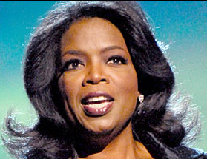
Oprah Winfrey
“Your holiest moments,
most sacred moments, are often the ones that are the most painful.”

Slide 102
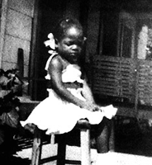
Oprah Winfrey
“I grew up a little Negro child who felt so unloved and isolated—the emotion I felt most as a child was loneliness– and now the exact opposite has occurred for me in adulthood.”

Slide 103
Stories rework deep
and vexing problems
to find wisdom and
direction in our own
experience.

Slide 104
Career Construction Dialogues
Concentrate on stories about how a client may use work to actively master passive suffering rather than just be used by work.

Slide 105

MEANING MAKING
CAREER CONSTRUCTION DIALOGUES
FIT WORK INTO LIFE
NOT LIFE INTO WORK

Slide 106

Answer Questions
Who am I?
What is my quest?
How may I use work to pursue purpose?

Slide 107
Lfie Designing Dialogues Construct
A story of mastery to transport client into the future.
Notes:
107

Slide 108

Clear and compelling story with thematic coherence and continuity clarifies choices and identifies what is at stake.

Slide 109
Narrative Knowing
Counselors use stories to gain immediate and direct entry into the experiential world of the client.

Slide 110

Connect counselor to client in culturally relevant and intensely personal way.

Slide 111
Clients tell counselors the stories that they themselves need to hear, because from all possible stories, they narrate those stories that support current goals and inspire action.

Slide 112
Stories Tell Us As We Tell Them.
Clients need to hear themselves say it.

Slide 113
The counselor’s purpose is to encourage de-automatized perception and narrative thinking to have client move to a new perspective from which to consider past experience and envision future possibilities.
Infuse new awareness and hope into old story and increase narratability of proposals for continuing a story which has been unfolding for years.

Slide 114
NARRATABILITY
Fit problem into larger pattern of meaning being lived.
Arrange alternative choices in this pattern.
Clarify what is at stake in making alternative choices
Use narrative to reduce confusion and
enhance ability to decide.

Slide 115
Stories Foretell Something Ahead
In telling their stories, clients are constructing a possible future.

Slide 116
Career Pattern
See career as a solution
to problems in growing up.
Identify the golden thread
or narrative theme

Slide 117
Career Construction Interview
How can I be useful to you as you
construct your career?
1. Who did you admire when you were
growing up?.
2. What attracts you to your favorite
magazines or television shows?
3. What is your favorite book or movie?
Tell me the story.
4. Tell me your favorite saying .
5. What is your earliest recollection?
Scene
Act
Self
Actor
Stage
Agent
Script
Author
Rehearsal
Advice
Back-Story
Arc

Slide 118
Transition Story
How can I be useful to you as
you construct your career?
The framing narrative tells how they hold their stories.
What does the Framing Narrative foretell or foreshadow?
How does it position the listener?

Slide 119
Early Recollections Tell CURRENT Perspective
  Stories reveal current perspective on self and the world.
These “memories” assign and express meaning to understand present experience and emotions.
  .

Slide 120
  Role models for self-construction reveal solutions to problems stated in early recollections.

Slide 121
Look for how role model solves the problems stated in the early recollections.

Slide 122
Refer solution story of role models back to problem story of early recollection.
They act as counterpoints to each other.
Have no need for courage if you are not frightened.

Slide 123



Going to Disneyland with grandparents and uncle and his girlfriend. I was in the back of the camper trying to sing and dance for my grandmother. She told me to sit down so I would not get hurt. I got on my uncle's girlfriend's nerves by trying to talk to her. Tried to talk but she did not think I should move around at the same time. Told me to sit still.

Slide 124

Little girl annoyed because she must sit still.

Slide 125

Ann of Green Gables
Spirit
Temper (I hide mine)
Set goals and goes after them
Does what she wants
Has integrity
Has fun

Slide 126
A 35 year old woman sought career counseling to consider her career options now that her son will enter first grade.

Slide 127
I remember at age three or four being in the hospital in my bed which had bars all around it. Up around it. The lights were low, the room was dark. I was waiting for my Mom to come to the hospital to sit with me. I got upset because I felt she was not going to show up. Time could not move fast enough. I remember that they gave me a 7 UP or Sprite while I was waiting. Finally she showed up and had a goose for me. It was Mother Goose.

Slide 128

She described Wonder Women, and implicitly herself, with the words helpful, strong but not violent, and always there to save the day.

Slide 129

What is your earliest recollection?
Going along with my mother on one of her protests.

Slide 130

Who did you admire?
SHE TRIED TO
BRIDGE TWO
WORLDS.

Slide 131


Age 5:
MY FATHER PROMISED ME A
PIANO AND I NEVER GOT IT.
CONFUSED AND RESENTFUL

Slide 132
It takes a good story about your own life to make a
highly effective career counselor. The story must:
Explain your calling to help others
Provide support for the hard work of counseling
Sustain a commitment to generativity for the long haul
Comfort you when things go wrong
Absorb the heartaches and burnout it may bring.

Slide 133
Does this outline fit your story?
-Symptom
  -Strength
    -Social Contribution
Meaning
at
Work
Working
at
Meaning

Slide 134




Slide 135

The Province of the Saved
The Province of the Saved
Should be the Art—To save—
Through Skill obtained in Themselves—
The Science of the Grave
No Man can understand
But He that hath endured
The Dissolution—in Himself—
That Man—be qualified
To qualify Despair
To Those who failing new—
Mistake Defeat for Death—Each time—
Till acclimated to.
Emily Dickinson

Slide 136

www.Vocopher.com

