Slide 1
The Construction of
Career Change
June 2017 NCDA Orlando, FL

Slide 2
Client Experience | Life Designing | Learning Cycle _{(Kolb, 1984)} | Client Operations _{(Watson & Rennie, 1994)}
Tension | Construct | Concrete experience | Symbolic representation
Attention | Deconstruct | Reflective observation | Reflexive self-examination
Intention | Reconstruct | Abstract conceptualization | New realizations
Extension | Co-construct | Active experimentation | Revisioning self

Slide 3
Client Experience | Life Designing | Learning Cycle _{(Kolb, 1984)} | Client Operations _{(Watson & Rennie, 1994)}
Tension | Construct | Concrete experience | Symbolic representation
The process begins with addressing a client’s tension by constructing micro-narratives that provide symbolic representations of concrete experience.

Slide 4
Client Experience | Life Designing | Learning Cycle _{(Kolb, 1984)} | Client Operations _{(Watson & Rennie, 1994)}
Attention | Deconstruct | Reflective observation | Reflexive self-examination
This is followed by deconstruction of limiting ideas and false beliefs with attention concentrated on reflective observation and self-examination.

Slide 5
Client Experience | Life Designing | Learning Cycle _{(Kolb, 1984)} | Client Operations _{(Watson & Rennie, 1994)}
Intention | Reconstruct | Abstract conceptualization | New realizations
Produce new intentions by reconstructing macro-narrative with abstract conceptualizations
that beget new realizations

Slide 6
Client Experience | Life Designing | Learning Cycle _{(Kolb, 1984)} | Client Operations _{(Watson & Rennie, 1994)}
Extension | Co-construct | Active experimentation | Revisioning self
And finally, client and counselor co-construct an action plan that extends revisioning of the self through active experimentation in the real world.

Slide 7
Client Experience | Life Designing | Learning Cycle _{(Kolb, 1984)} | Client Operations _{(Watson & Rennie, 1994)}
Tension | Construct | Concrete experience | Symbolic representation
Attention | Deconstruct | Reflective observation | Reflexive self-examination
Intention | Reconstruct | Abstract conceptualization | New realizations
Extension | Co-construct | Active experimentation | Revisioning self

Slide 8
The Construction of Career Change
The Career Construction Assessment encourages
reflection by eliciting small stories about career.
Career Construction Counseling reconstructs the micro-narratives into a macro-narrative that transforms the career problem and co-constructs intentions that will master the developmental task, occupational, or work trauma.

Slide 9
CCI Assesses Five Core Micro-Narratives
Core micro-narratives reveal frequently used meanings or constructs that have a critical role in producing and organizing a client’s career narrative.
Career construction counselors use the CCI to identify the micro-narratives and their theme.
Use reflexivity to reconstruct micro-narratives into a macro-narrative that forms a new perspective, increases coherence and continuity in the client’s autobiography , and reconceptualizes and resolves the career problem.

Slide 10
Innovative Moments
IMs occur when a client engages in novel actions, thoughts, or emotions that differ from those in then narrative about the career problem.
Gonçalves, M. M., Ribeiro, A., Mendes, I., Matos, M., & Santos, A. (2011). Tracking novelties in psychotherapy process research: The Innovative Moments Coding System. Psychotherapy Research, 21, 497-509.

Slide 11
Innovative Moments
IMs are deviations from the problem narrative.
Can change the way a client tells the story
IMs present opportunities for changing the narrative and resolving the problem.

Slide 12
Innovative Moments
Elaboration of IMs brings about change
Central role in narrative transformation

Slide 13
The consolidation of emerging new meanings or Innovative Moments enables a client to reconstruct a new career narrative that revises and transforms the career problem, leading to action in the real world.

Slide 14
Transition Story
A Framing Story to Position Listener for Stories to Come
It describes a disruption or deviation, a gap that needs to be filled, so as to become whole and complete.

Slide 15
Problematic Career Narrative
Narrative about difficulties with a vocational development task, occupational transition, or work trauma.
  What does problem mean to client
  How does client experience it
  Consider broader influences in client’s context
  Understand client’s expectations

Slide 16
Career Construction Interview Questions
How can I be useful to
you as you construct
your career?

Slide 17
Make sense of transition story by viewing it as dimly foreshadowing the development of thematic concern.
They have content in prospect.
They lean forward and point to the future

Slide 18
They prepare the ground and foreshadow the plot, and establish a mood.
They beckon us forward, promising new insights, complications, crises, and resolutions.
They draw us in with specific expectations.

Slide 19
Listen for Changes in Career Narration
Action IMs
Reflection IMs
Protest IMs

Slide 20
Action
Specific behaviors that counter the problem
New coping behaviors
Exploring new contexts
Seeking information
Searching for new solutions

Slide 21
“I signed up to volunteer as a Big Brother.”
“I’m looking into a training program that will teach me new skills and give a certificate.”

Slide 22
Reflection
New ways of thinking, feeling, and understandings about the problem that allow a client to defy its demands
- Considering what caused the problem
- Thinking about how it impacts the client’s life
- Identifying negative effects of the problem
- How to deal with the problem in future
- Deliberate on changes created by counseling

Slide 23
“The best time in my life was when I worked on a sales team.
“I am a friendly guy but my boss yells at me for talking too much and to too many people.”
“But I've never tried because I'm afraid to get denied.”

Slide 24
Protest
Criticizes the problem or those who support the problem including self
Active refusal of assumptions and prescriptions in problematic career narrative
Emergence of new, self-empowered positions
Repositioning oneself in different way toward the problem.

Slide 25
“I don't want a… I don't want no part of that.”
“My Father says a ‘Father’s need is Son’s deed.’ But I do not want to join the family business as his partner.”

Slide 26
“Ambivalence Markers
Ambivalence
After the elaboration of an IM, a client immediately reaffirms the problematic career narrative.
Return to the Problem Markers (RPMs) may predict poor outcome

Slide 27
“There are loopholes for everybody else but not for me. I just don't have the million connections.”
“Maybe my mother is right and I should become a teacher for the job security.”

Slide 28
Reconceptualization
Form a new self-narrative using reflexivity
Client sees self in a new way
Telling the story with intentional self-regulation
Counselor may pull them out or co-construct them

Slide 29
Reflexivity is a second-order cognitive process whereby an individual reflects on retrospective reflections to first understand and recognize patterns in one’s self-narratives and then prospectively project the career story into the future.

Slide 30
Reflexivity
Reflexivity uses internal dialogues to take a new perspective that transforms the career narrative and approaches the transition in a new way.

Slide 31
Reconceptualization
Articulation of new understandings
Meta-perspective that takes three positions:
the position of the past story
the position of the anticipated (new) story
an observing position that recognizes the difference between the old and the anticipated plots as well as describes the process of change.

Slide 32
Reconceptualization
Formation of a new self-narrative
Involve a reflexive (recognize our own influence) position toward the change process—the person is not only an actor in that process but also its author.
Without this meta-perspective, the person could only be an actor who lacks access to the processes that are beneath the plot; it is the access to these processes that allows him or her to be an author or his or her own life
Without reconceptualization the other IMs seem insufficient for sustained therapeutic change to unfold

Slide 33
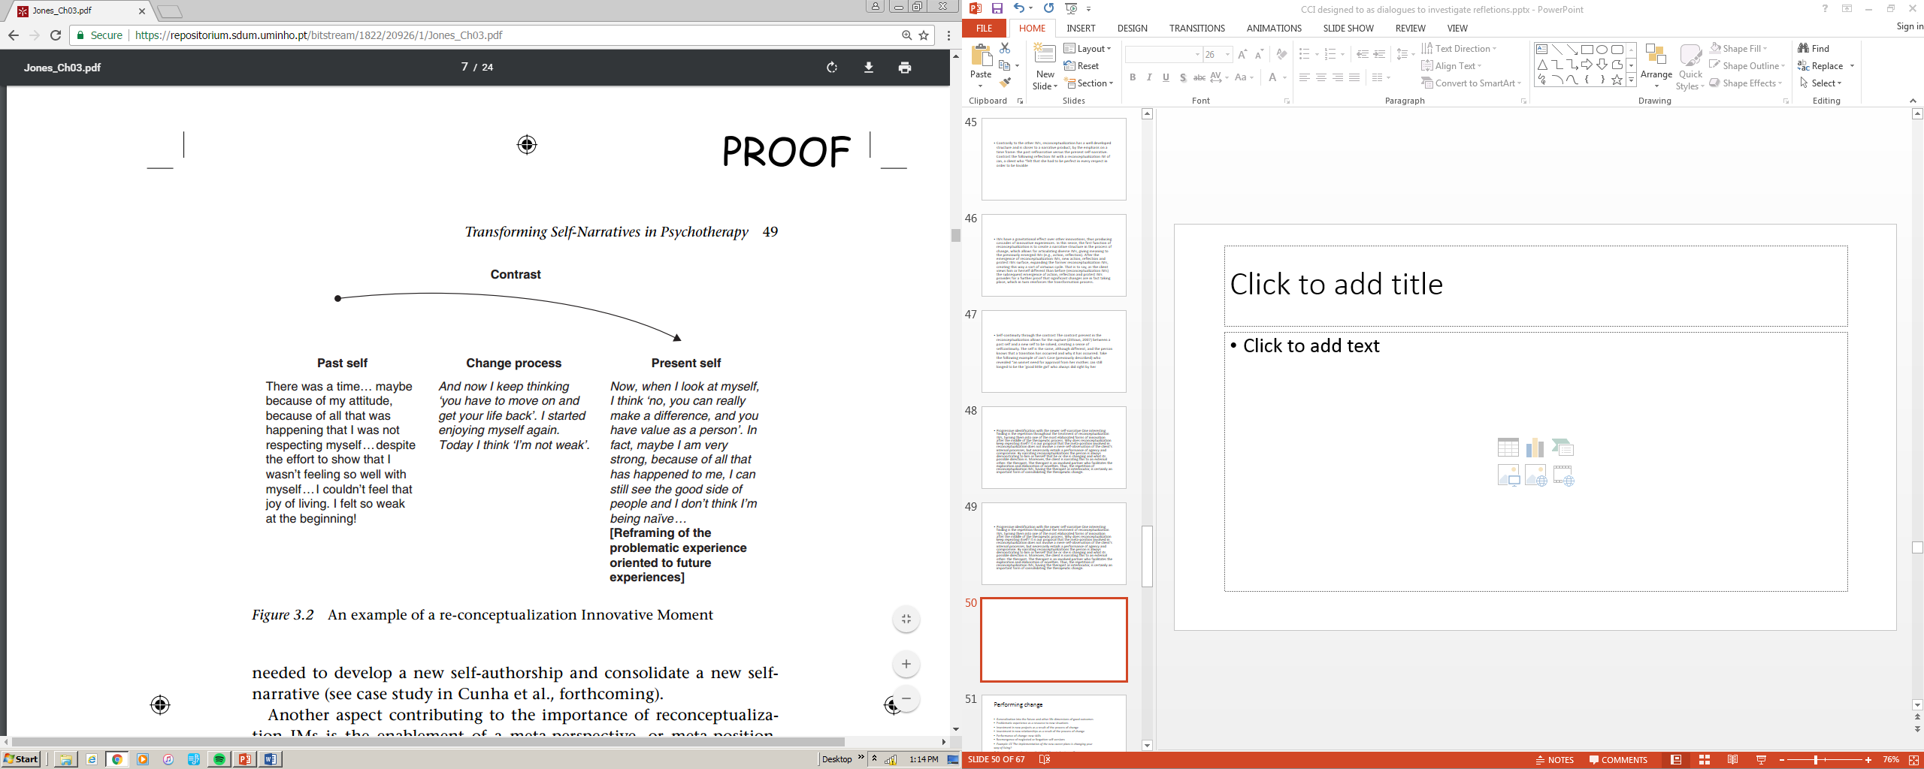
REFLEXIVITY
REFLEXIVITY
Observing Position
Gonçalves, M. M., Ribeiro, A., Mendes, I., Matos, M., & Santos, A. (2011). Tracking novelties in psychotherapy process research: The Innovative Moments Coding System. Psychotherapy Research, 21, 497-509.

Slide 34
Reconceptualization
Articulation of new understandings
Narrative thought helps the autobiographical author to move to a new perspective, envision possible futures, and trust intuition.
Brings career story to point of meaning & purpose
Highlights meaning and uniqueness to shape identity and future plans.

Slide 35
“Oh yeah, looking at that way, I could stop feeling sorry for myself and go sign-up for a project manager course right now and go to school, 3 nights a week for a year and get the certificate that will lead to the job I want.”
“If when I graduate, I move out on my own I can pursue the career that I want without feeling guilty about not doing what my family wants.”

Slide 36
Reconceptualization
The new narrative that emerges in reconceptualization is not a complete or finished story.
It is a provisional, first draft of what a new narrative could be.

Slide 37
Performing Change
The implementation of the new career plans
Engaging in new projects as a result of the process of change
Performing new skills or activities
Incorporating ignored interests and values

Slide 38
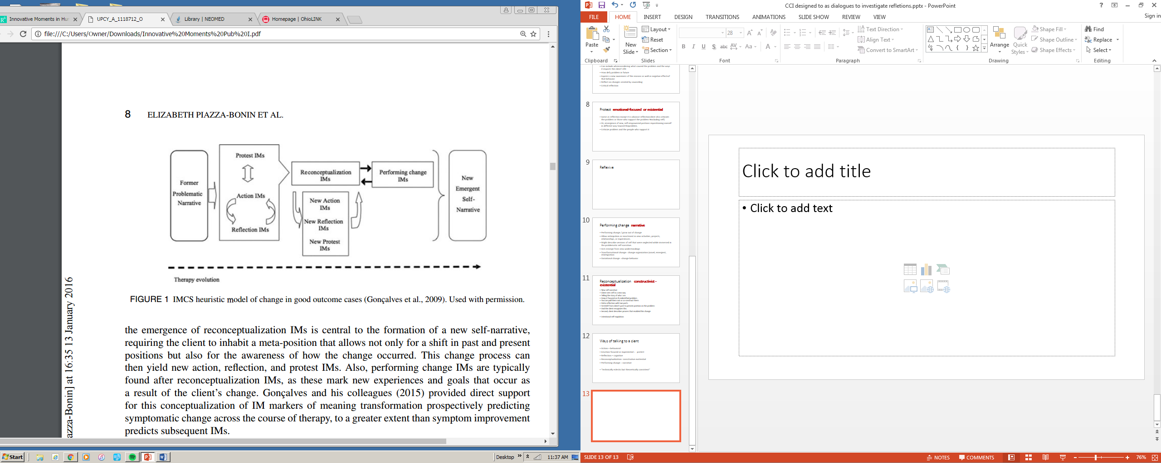
Gonçalves, M. M., Ribeiro, A., Mendes, I., Matos, M., & Santos, A. (2011). Tracking novelties in psychotherapy process research: The Innovative Moments Coding System. Psychotherapy Research, 21, 497-509.

Slide 39

Life Designing Dialogues
Construct a self-defining story with coherence and continuity by reflexively and selectively reconstructing the past in such a way that it seems to have been rehearsal for what comes next.

