Slide 1
Using Inventories and Manifest Behavior to Assess Vocational Interests and Construct Careers
Mark Savickas
Suzanne Savickas

Slide 2
June, 2017 NCDA Orlando, Fl

Slide 3
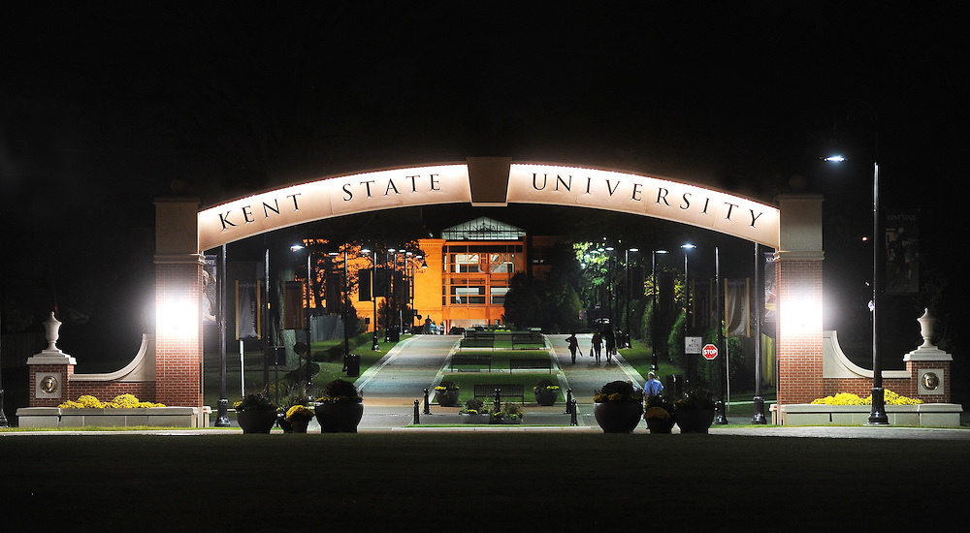
Save the Date:
2018 Career Construction Institute
Where:
Kent State University,
Hotel and Conference Center
When:
July 23rd-25th 2018
Accommodations:
Kent State Hotel and Conference Center, www.kentstatehotel.com, Code: CCI2018
Explore Downtown:
http://www.kent.edu/engagement/upcoming-conferences

Slide 4
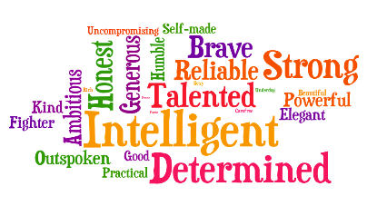



Social actor plays a character
Motivated agent pursues goals
Narrative authors writes life story
Actor
Agent
Author

Slide 5
SOCIAL ACTOR
Characteristic ways of doing
Broad differences in social behavior (McAdams)
Social performances (Goffman)
Reputation (Hogan)

Slide 6
MOTIVATED AGENT
Evolves middle to late childhood
Purposive goal-directed agents
Develop goals, strivings, projects, plans for their own lives.
Interests describe how individuals might behave in pursuing goals.

Slide 7
Actors (doing) become
agents (striving)
Agency is means by which something is done; the means or mode of acting; an instrument or vehicle

Slide 8


Slide 9


Slide 10


Slide 11
Motivational Constructs
Need Interest Value
Why How What

Slide 12
Need
A lack of something
A requirement
A necessity

Slide 13
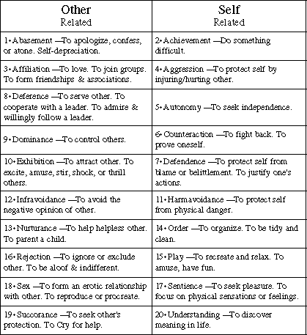
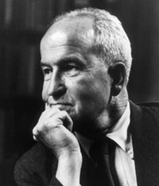
Henry Murray

Slide 14

Value
Desirable
Useful
Important

Slide 15

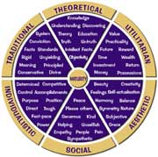

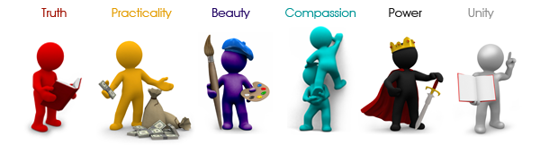
1914

Slide 16
INTER EST

Slide 17
Between It Is
INTER EST

Slide 18

Interest
The feeling when one’s attention, concern, or curiosity is particularly engaged by something.
A psychosocial tensional state between a
person and environment.

Slide 19

INTERESTS
Values = Objectives
Interests = Objects & Activities
through which
objectives are
attained

Slide 20
Need Interest Value
Why How What

Slide 21
The second question inquires about interests.
It aims to identify types of environments that draw one’s interests.

Slide 22

Construct your world and stand in your favorite space.
A stage on which the self may perform.

Slide 23


Slide 24
Environments
People select contexts that enable expression of their motives.
These ecological niches provide coherent pathways, opportunities, rituals, social conventions, and moral guidelines.

Slide 25
Work Environments
Occupation is a set of requirements, routines, and rewards.

Slide 26
Occupations
Occupation is a social strategy by which to sustain oneself.

Slide 27
An occupation is a means of social integration.
Occupations provide socially-organized pathways for contributing to society and making a living.
Occupational fields are constructs that society uses to structure and classify work activities.

Slide 28
A Stage for Acting in the Social World
A stage is a raised platform on which an actor performs.
A platform is a place, a means, or an opportunity for public expression.

Slide 29
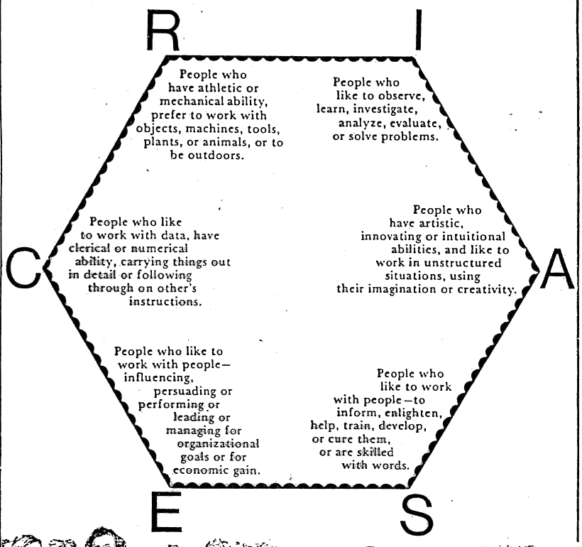

Slide 30
RIASEC
A knowledge system
A vocabulary of distinctions
Languaging of self and occupations

Slide 31
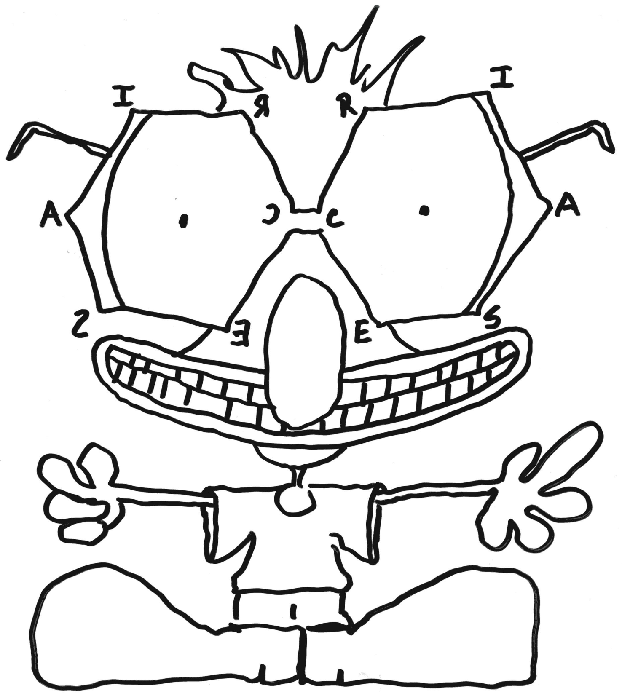

Slide 32
Goals and interests are sensitive to contexts and change over time

Slide 33
Assessing Interests
INVENTORIED
TESTED
EXPRESSED
MANIFESTED

Slide 34
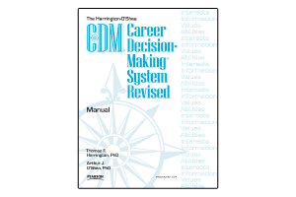






Inventory

Slide 35
LENTIL
LINTEL

Slide 36
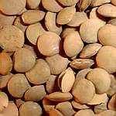
Lentil, a Legume

Slide 37
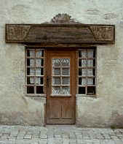
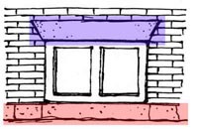
Lintel and sill

Slide 38
SCREE

Slide 39
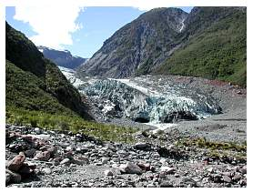


Slide 40
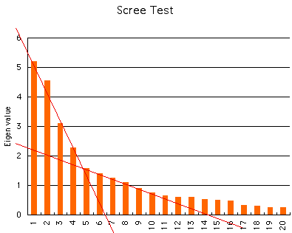

Slide 42
DOTTLE

Slide 43
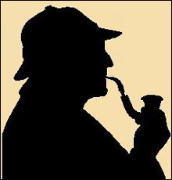

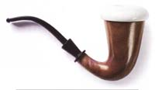
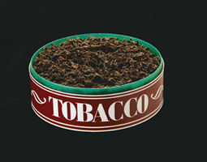
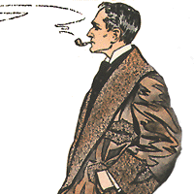

Slide 44


Slide 45
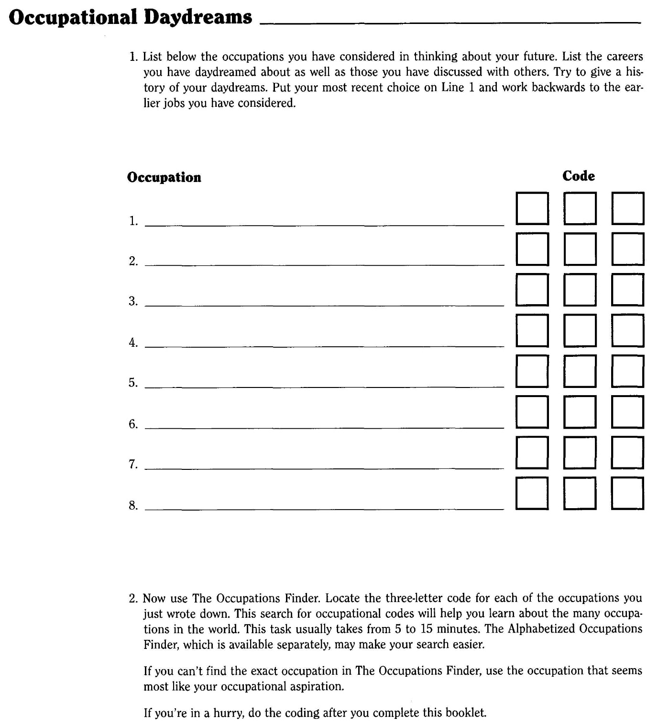
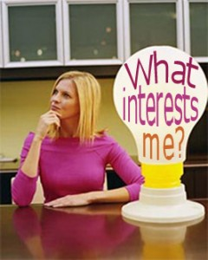

Slide 46
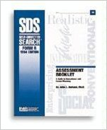

Slide 47


Slide 48


Slide 49
Assessing Interests
INVENTORIED
TESTED
EXPRESSED
MANIFESTED

Slide 50

Logarithms

Slide 51


Slide 52
What is your favorite magazine?

Slide 53


Slide 54


Slide 55
2. Do you read any magazines regularly?
What do you like about these magazines?
enjoy, prefer find interesting

Slide 56


Realistic Magazines

Slide 57
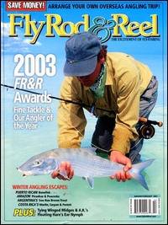

Slide 58
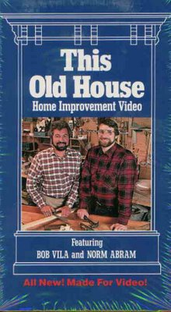



Slide 59

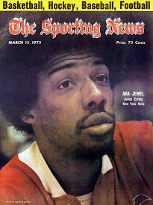

Slide 60

Investigative Magazines

Slide 61


Slide 62



Slide 63


Slide 64


Slide 65

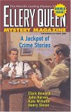



Slide 66

Artistic Magazines

Slide 67





Slide 68







Slide 69







Slide 70


Slide 71
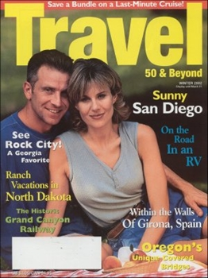
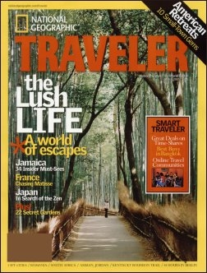


Slide 72



Slide 73

Social Magazines

Slide 74


Slide 75



Slide 76


Slide 77




Slide 78


Slide 79

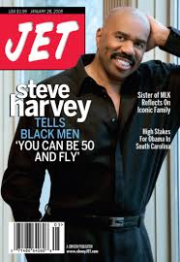

Slide 80


Enterprising Magazines

Slide 81
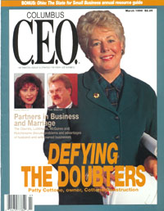

Slide 82
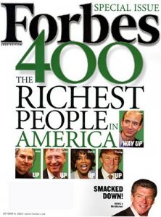

Slide 83


Slide 84


Slide 85







Slide 86



Slide 87
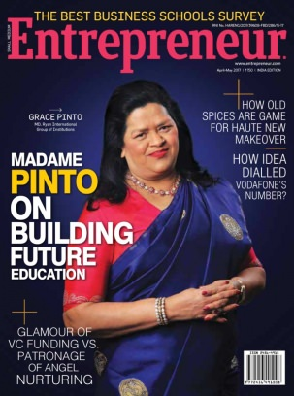


Slide 88

Conventional Magazines

Slide 89


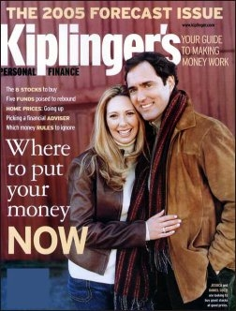

Slide 90

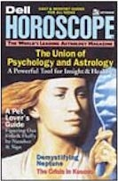



Slide 91


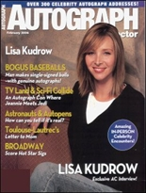



Slide 92
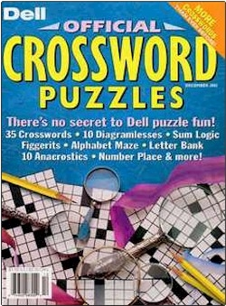

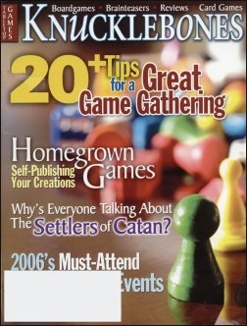

Slide 93
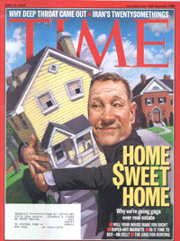
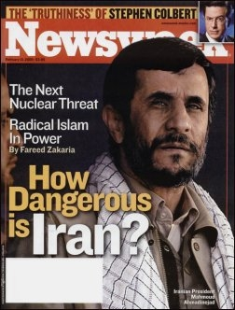

Slide 94
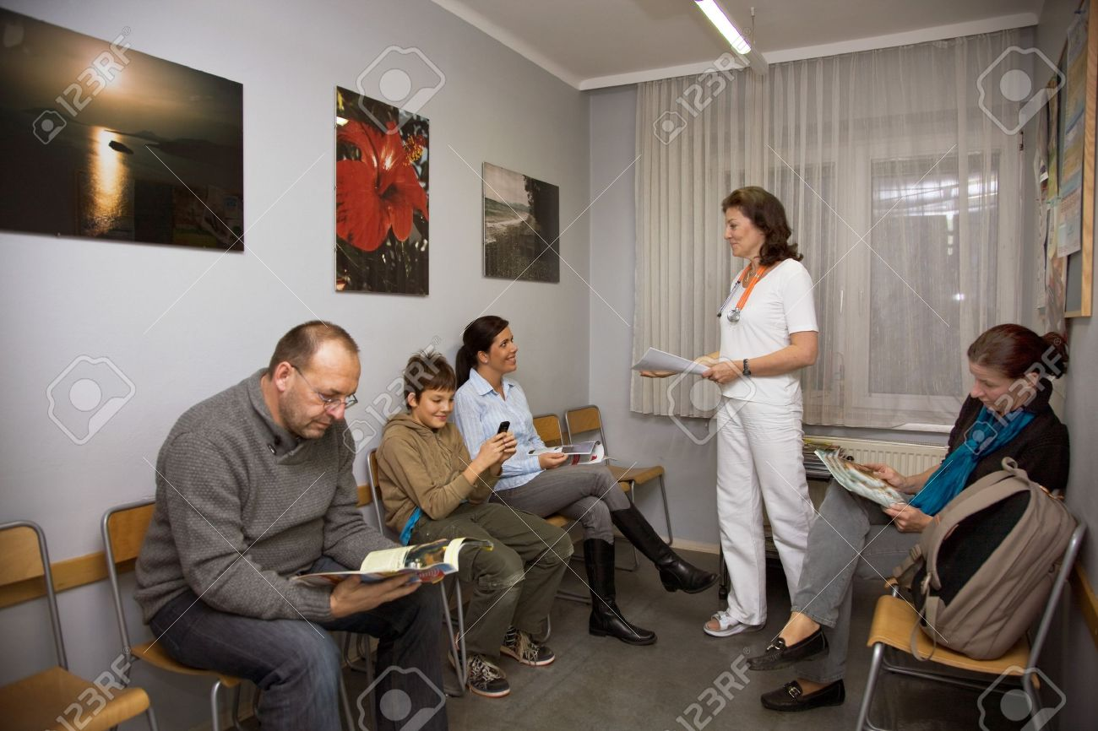

Slide 95

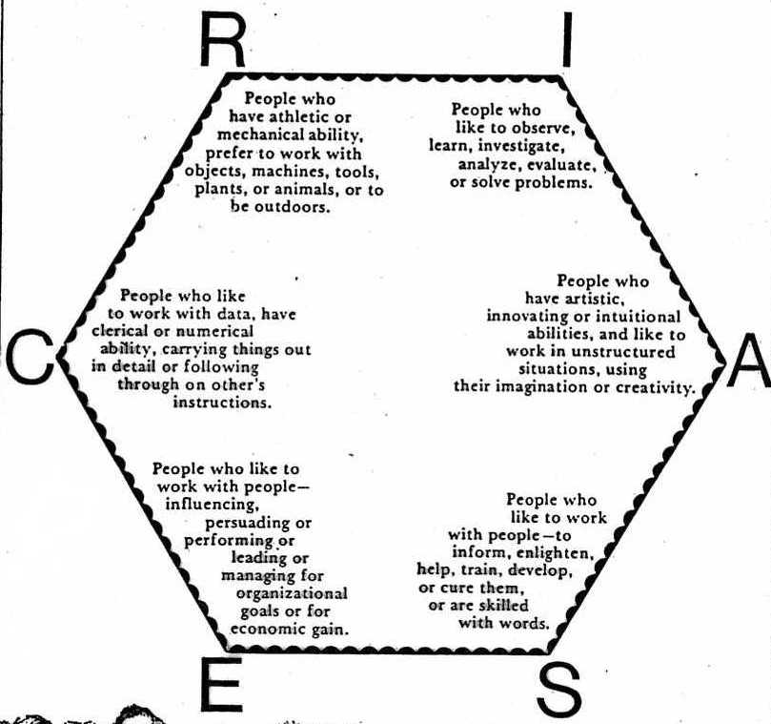

Notes:
95

Slide 96
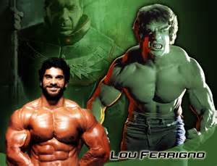

Slide 97


Slide 98
What is your favorite television show?

Slide 99
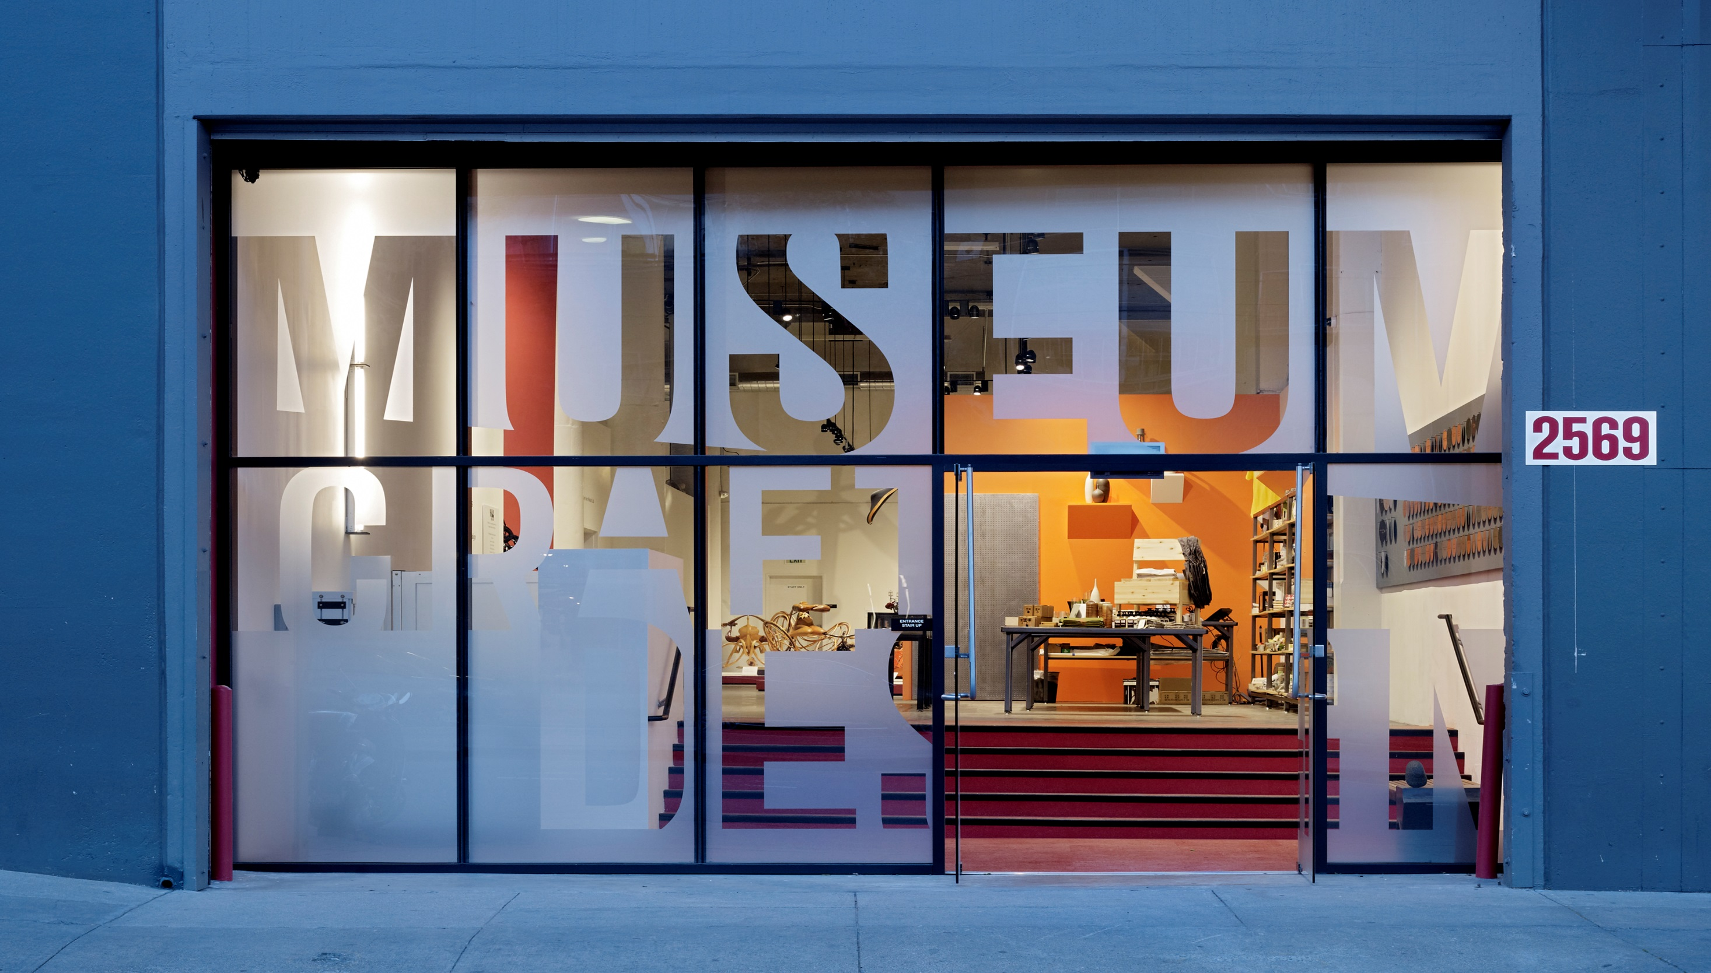

Slide 100

Television shows the world.

Slide 101
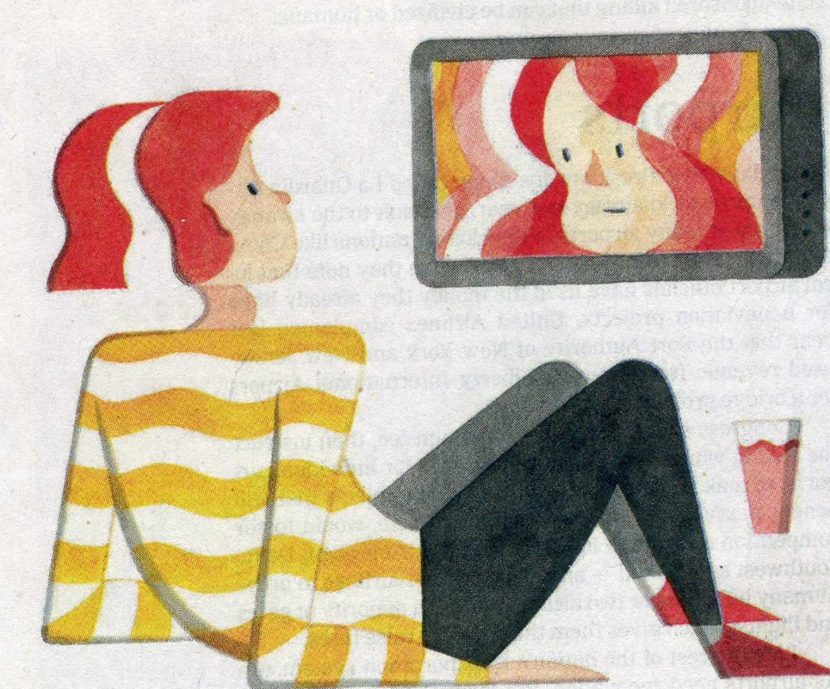

Slide 102
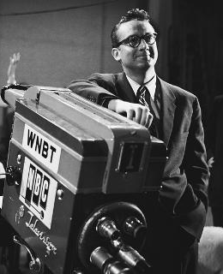


Slide 103


Slide 105


Slide 106


Slide 107
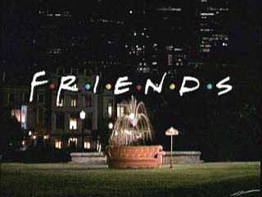
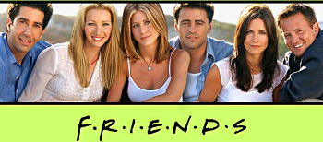
Notes:
107

Slide 108


Slide 109


Slide 110


Slide 111
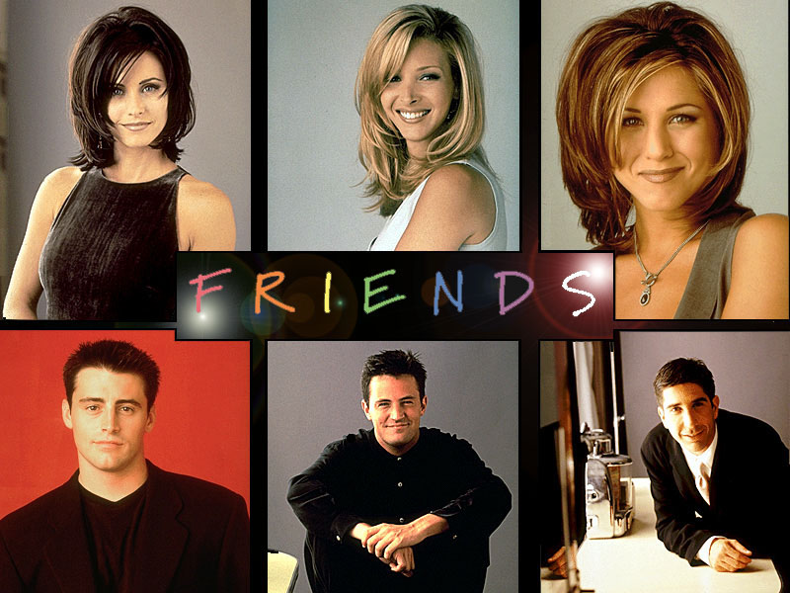
Notes:
111

Slide 112
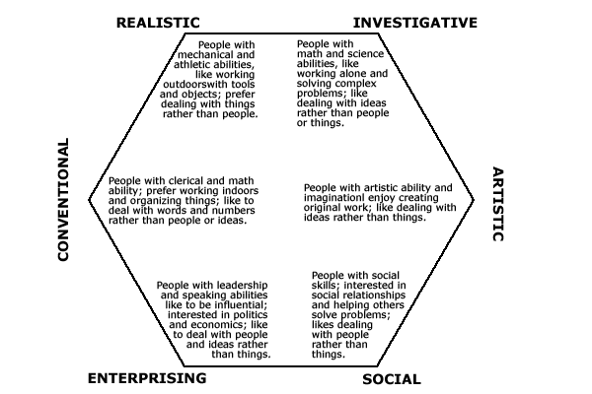
Notes:
112

Slide 113
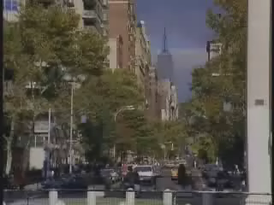
Notes:
113

Slide 114

Notes:
114

Slide 115
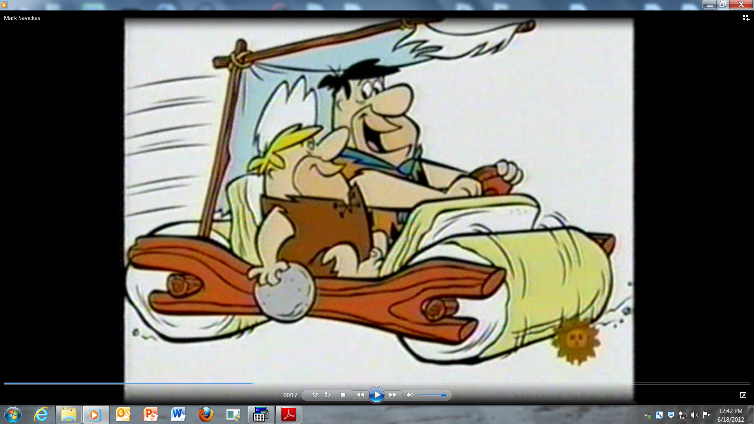

Slide 116


Slide 117


Slide 118


Slide 119
Television shows the world.

Slide 120


Slide 121


Notes:
121

Slide 122






Notes:
122

Slide 123
What is your favorite website??

Slide 124

Web-Sites

Slide 125


Slide 126
Notes:
126

Slide 127

Breaking Bad

Slide 128

About a brash, tattooed character who drives trucks across frozen lakes.

Slide 129


The president has described television as his biggest guilty pleasure. His two favorites as “House of Cards” and “Homeland.” All-time favorite show MASH

Slide 130

At a meeting in December, President Obama joked about how the lead character, played by Kevin Spacey, deftly managed Congress.
“I wish things were that ruthlessly efficient,” he said. “I was looking at Kevin Spacey and thinking 'Man, this guy's getting a lot of stuff done.'”

Slide 131


Went from mechanic to employment specialist. Drug addict who got clean.
Walking Dead –people trying to survive, team that helps each other out.
Blacklist = He went to the wrong side of the tracks; wants to redeem self; work together to put bad people away

Slide 132
After recovering from addition, he went from mechanic to employment specialist.

Slide 133
The walking Dead about a group of people fighting to survive in the post-apocalyptic world. The main group encounters other survivors, some friendly while others not so much and conflict ensues.

Slide 134
HIED student with BS in public health
I connect TWD to HIED and the work I want to do in TRIO students and disadvantaged student are fighting to find their niche in the tumultuous education system. They will encounter friends and they will encounter foes but they must survive somehow. TWD group has to learn how to live in a post-apocalytic world and also how to live with other survivers. First generation college students have to learn how to survive in college while also learning to survive with those around them who do not have the same or similar background.

Slide 135

About helping people out of impossible situations.

Slide 136
I want to help people make important decisions that solve impossible problems in their lives. I want to be a clinical mental health counselor so I may help people go into the darkest corners of their minds where they fear to go.

Slide 137

A show called Sarabhai Vs Sarabhai – Take 2 about a family with minor misunderstandings but stays together and learns to accept each others’ minor imperfections.

Slide 138
I want to be a family therapist.

Slide 139



Magazines

Slide 140
I dream of
becoming
a chef.

Slide 141

About young Queen Mary of Scots; who is a very smart, passionate, young women willing to confront people with issues, navigate other country’s political systems, and do what is right even if it means giving-up her own happiness.

Slide 142
I am voc rehab student who is passionate about dong right things for others even if it costs me my own happiness.

Slide 143

Gilmore Girls
Tells the story of everyday woman and daughter—not accepted by family.

Slide 144
I want to work with women or teenage girls who need support, need to gain self-esteem, whether it is personal issues, relationship issues, domestic violence, or eating disorders. I want to empower women.

Slide 145

Its about parallel worlds. Trying to figure out what is going on, wants to equal things out. Help them figure out for themselves about two worlds.

Slide 146
I am studying rehabilitation counseling.
I want to organize services for individuals who are released from prison.

Slide 147


Burn Notice because of mystery and intrigue
Intervention because of the addiction and guidance

Slide 148
I want to be an
addiction specialist.

Slide 149

Saudi Arabia Magazine
It is intellectual in scope. It has stories about traveling for supporting people in danger because of war or starving.

Slide 150

Realizing that no matter how long its been, truth can be recovered and never lose hope.

Slide 151
Pastor studying for a
Doctorate in Divinity
School counseling student with SRI code.

Slide 152

About a sports psychologist that helps a star on the pro football team, and then helps other athletes. I love athletics and that she helps others accomplish their goals.

Slide 153
School counseling
student with
SRI code.

Slide 154


Boy Meets the World addresses serious life issues and transitions, supportive family
American Idol-people transform from everyday citizen to superstars. People find their place in the world.

Slide 155
I want to become a clinical mental
health counselor and work with
people who need to make big
changes in their lives.

Slide 156

Big Bang Theory- people with great knowledge but no social skills, Penny teaches them about social skills and relationships though they sometimes consider her unintelligent because she lacks a degree or any scientific aptitudes

Slide 157
I want to work
in residence life.

Slide 158


Doctor Who is always wondering if he is making the right decision and thinks greatly before he does anything.

Slide 159
I think that I would like to
specialize in
career counseling.

Slide 160

Project Runway- Fun to see the ingenuity of their designs, especially when the materials are unconventional such as groceries or supplies form a party store.
Tim Gunn consults with them and helps them reach their design potential, which stems from their personal strengths.

Slide 161
As a school counselor, I will be able to help students build on their strengths and interests. Help them develop problem-solving skills in different situations.

Slide 162

shows a world where people stand up for one another. It’s a setting where people who are different still come together to do great things. It’s a place where people may not be safe and happy all the time, yet they always have someone there to support them.

Slide 163
I want to be a
residence hall director.

Slide 164




I like to constantly improve myself through what I eat, think, staying active, and treat myself well.

Slide 165
I want to work with individuals who have eating disorders
and body image problems.

Slide 166


American Idol= show helps people live their dreams.
Teen moms= “messed up lives” and relationships. Sad and horrible but interesting. I always wish that I could talk with them and help them to see all the toxic things they do and people in their lives.
Secret life of an American teen-ager—teenage girl with a baby, facing relationship issues and making life decisions as well as dealing with school, friends, and her parent’s divorce. Other characters are dealing with similar issues.

Slide 167
I want to work
with pregnant
teens.

Slide 168

Intervention follows drug addicts as they purchase and use drugs. It shows real people having real problems.
True Life= different topic each show. My favorite episodes are about drug addicts/eating disorders, strange medical conditions, and other taboo

Slide 169
Clinical Mental Health Student
I want to work in a
rehabilitation
clinic.

Slide 170

I like the stories about sex.

Slide 171

I like the embarasing discussions of sex.

Slide 172
I want to become a sex therapist.

Slide 173



Slide 174
Career Counselor at a University
I relate this show back to what I want to do in advising. I want to help students in highly rigorous or competitive program who are just not cutting it find a new path. I want to help them explore their skills and interests and make their “plan B” an even better fit than their “plan A”. In this case, my students are the houses I see on the remodeling shows. It is taking homes that no one wants, fixing them up, and re-shaping them to the market. Here is the real revelation though, it blew my mind to no end while… the real answer is that I do not want to tear out students old qualities and skills telling them how to act. But instead I want to help students be aware of their own skills and qualities polishing them up until they shine. I love Property Brothers because it is about fixing houses because I do not want to gut the houses.

Slide 175
All three of my shows are about people who are trying to overcome their own life issues for some kind of goal. The underlying themes reiterates my passion to become a school counselor.
Glee = high schoolers who have issues,
a diverse group Make or Break It = a team working to overcome
their own personal psychological issues
I Used to be Fat = teenagers overcoming
obstacles in life.

Slide 176

Michael

Slide 177


Slide 178

The economics of the industry
How developers get started
Innovations

Slide 179

Science
Technology innovations
Anthropology

Slide 180
Save the Date:
2018 Career Construction Institute
Where:
Kent State University,
Hotel and Conference Center
When:
July 23rd-25th 2018
Accommodations:
Kent State Hotel and Conference Center, www.kentstatehotel.com, Code: CCI2018
Explore Downtown:
http://www.kent.edu/engagement/upcoming-conferences

Slide 181


William Glasser

Slide 182


Sigmund Freud

Slide 183


Aaron Beck

Slide 184



John B. Watson

Slide 185



George Kelly

Slide 186






Slide 187







Slide 188
Gestalt Prayer
I do my thing and you do your thing.
I am not in this world to live up to your expectations
And you are not in this world to live up to mine.
You are you and I am I,
If by chance we find each other, it’s beautiful.
If not, it can’t be helped. (Perls, 1969, p.4)

Slide 189





Slide 190


Slide 191





Slide 192





Slide 193





Slide 194






Slide 195




Slide 196


Slide 197


Slide 198


