Slide 1
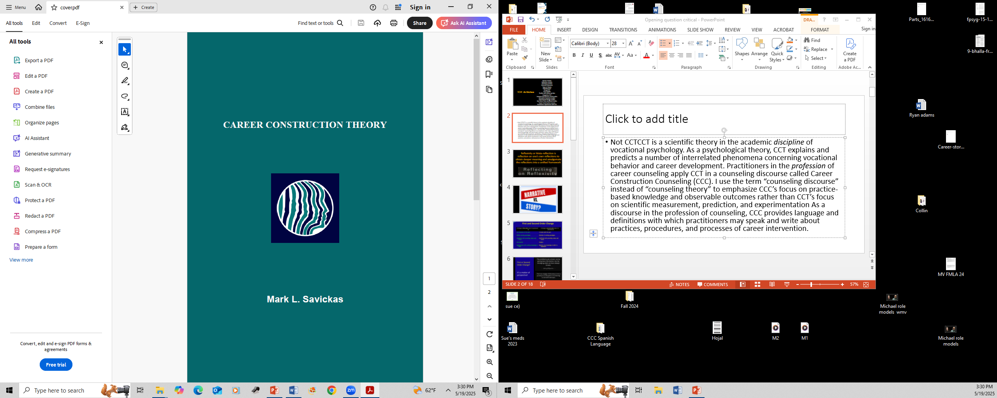
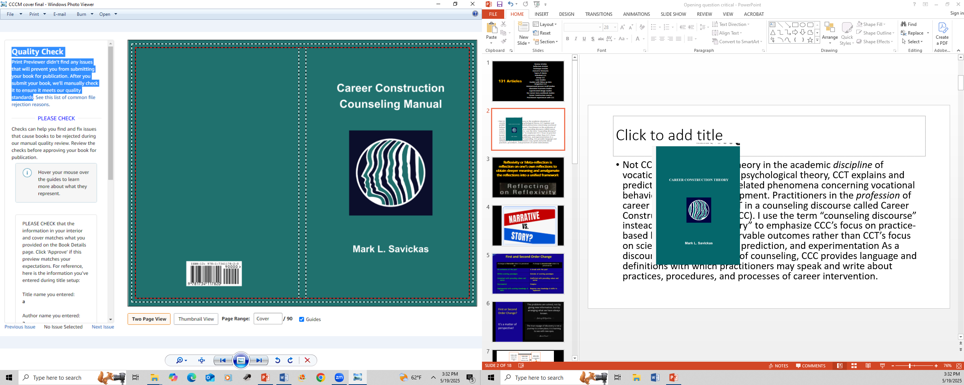
In the academic discipline of vocational psychology, Career Construction Theory is a scientific theory that explains and predicts a number of interrelated phenomena concerning vocational behavior and career development.
In the profession of career counseling, practitioners apply a counseling discourse called Career Construction Counseling. I use the term “counseling discourse” instead of “counseling theory” to emphasize CCC’s focus on practice-based knowledge and observable outcomes rather than CCT’s focus on scientific measurement, prediction, and experimentation.

Slide 2
Review Articles
Reflection Articles
Technique Articles
Outcome Measures
Types of clients
Individual CCC
Group CCC
Case Studies
Studies with follow-up data
Integrative CCC
Interpersonal process recall studies
Innovative moments studies
Experimental design studies
My Career Story workbook studies
Career Construction courses
Practitioner experiences with CCC
133 Articles

Slide 3
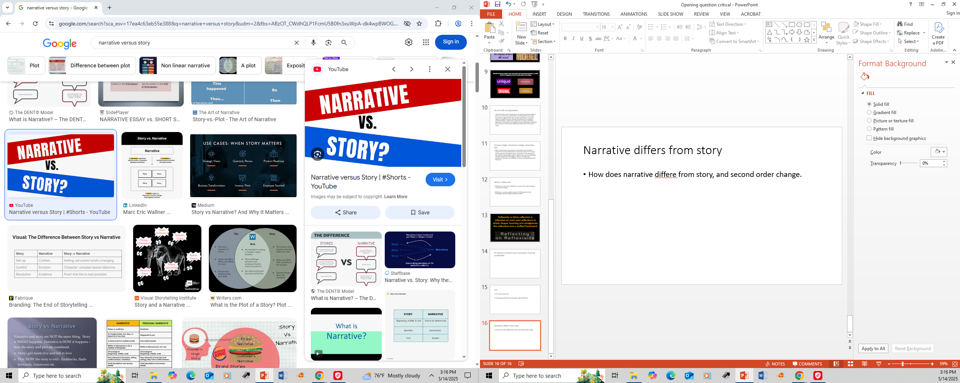
Narrative differs from story
How does narrative differe from story, and second order change.

Slide 4
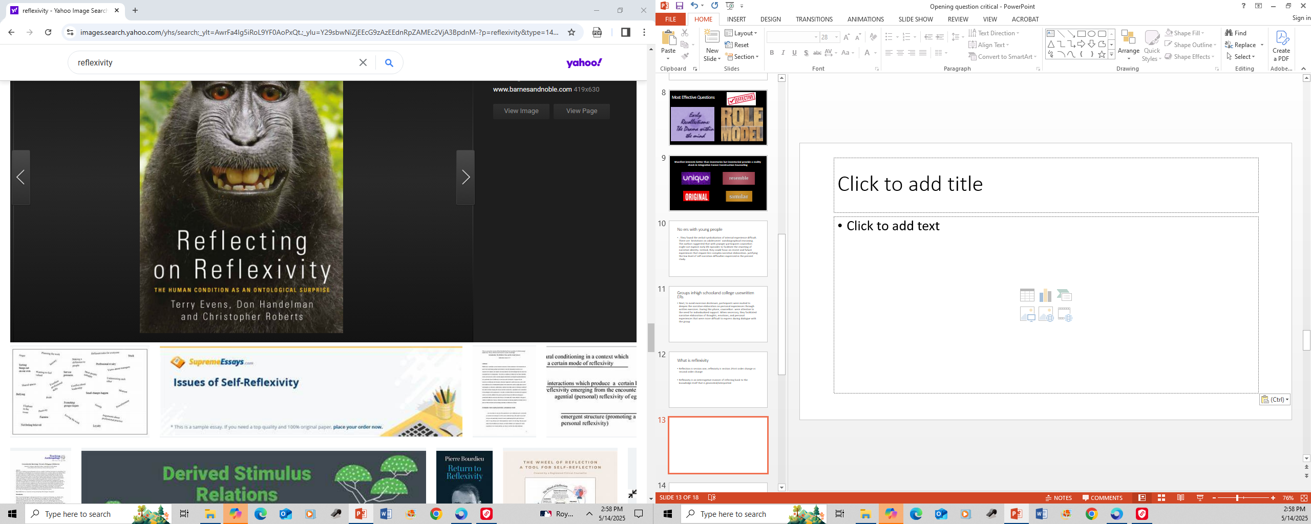
Reflexivity or Meta-reflection is reflection on one’s own reflections to obtain deeper meaning and amalgamate the reflections into a unified framework

Slide 5
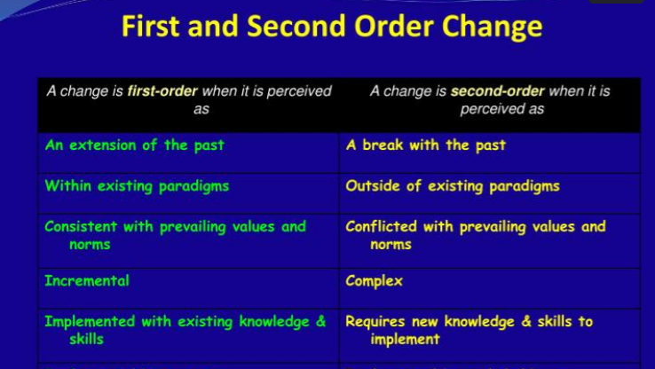

Slide 6
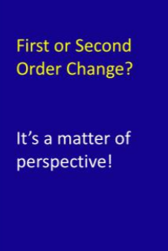
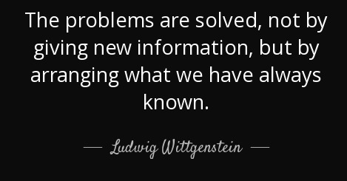
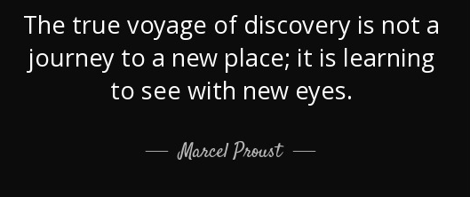

Slide 7
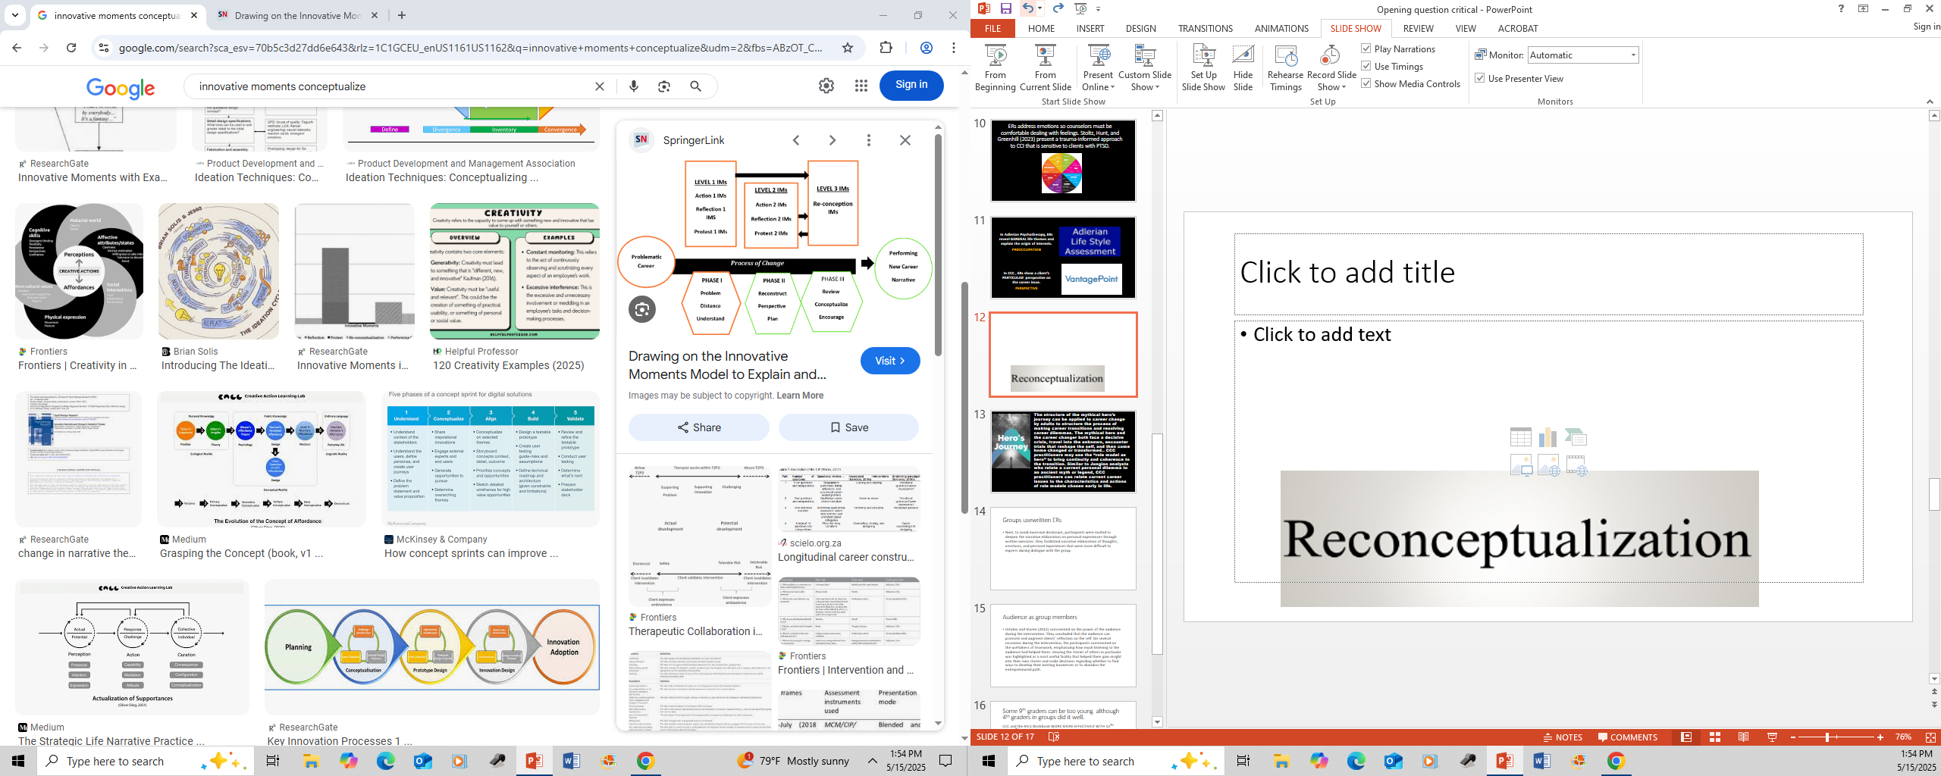
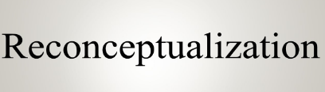

Slide 8
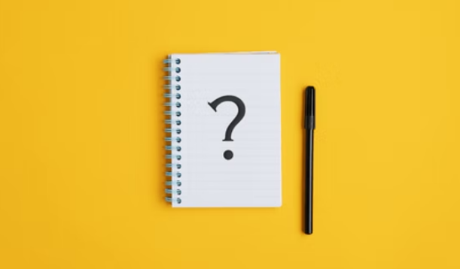
Opening question critical

Slide 9

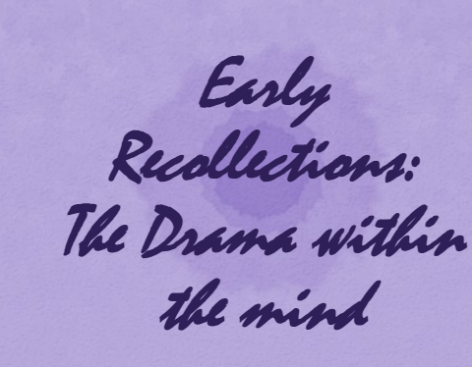
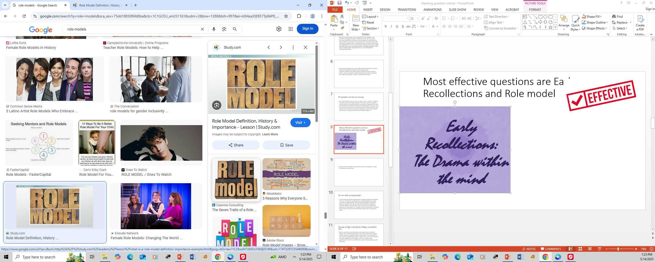
Most Effective Questions

Slide 10

In a few studies of CCC and the MCS Workbook, SOME younger individuals (9th grade and below) had trouble with role models and ERs --- because of difficulty with verbal symbolization of experience. No trouble with television shows, favorite story, nor motto.

Slide 11

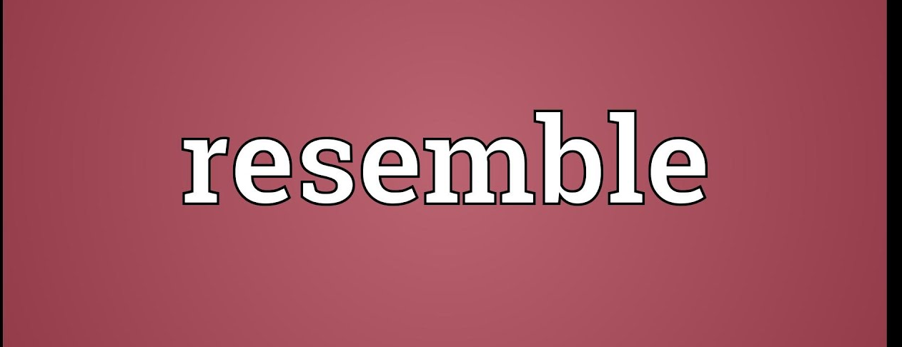


Manifest interests better than inventories but inventoried provide a reality check in Integrative Career Construction Counseling

Slide 12
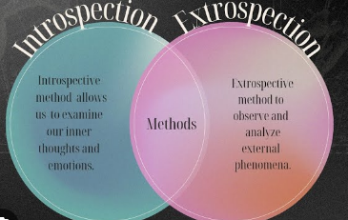
Extrospection is perceiving and reasoning about the external world and your experiences within it.
Inventoried
Interests
Manifest
Interests

Slide 13
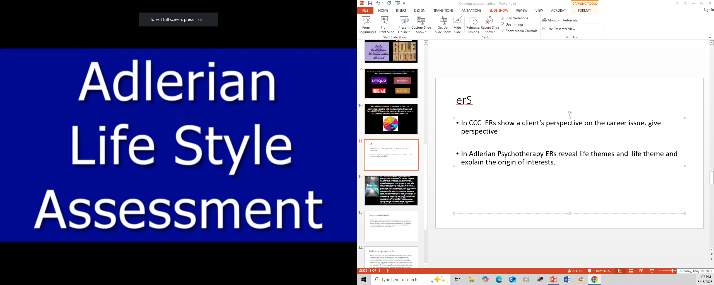

In Adlerian Psychotherapy, ERs reveal GENERAL life themes and explain the origin of interests.
PREOCCUPATION
In CCC , ERs show a client’s PARTICULAR perspective on the career issue.
PERSPECTIVE

Slide 14
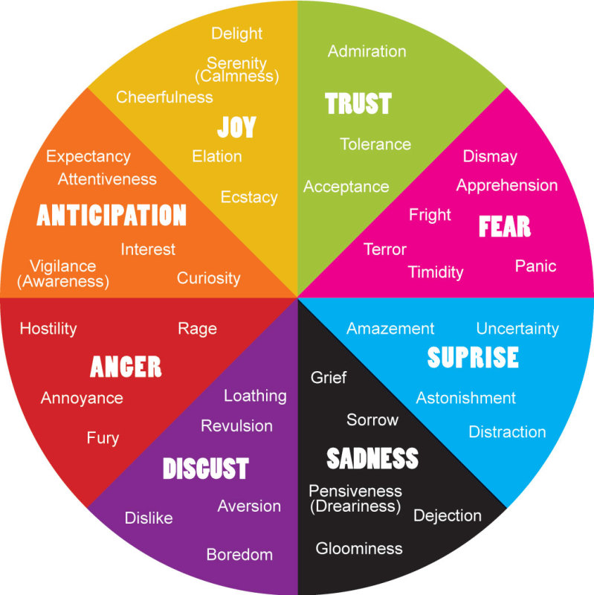
ERs address emotions so counselors must be comfortable dealing with feelings. Stoltz, Hunt, and Greenhill (2023) present a trauma-informed approach to CCI that is sensitive to clients with PTSD.

Slide 15

The mythical hero and the career changer both face a decisive crisis, travel into the unknown, encounter trials that reshape the self, and then come home changed or transformed.
CCC practitioners may use the “role model as hero” to bring continuity and coherence to the transition.
Similar to Jungian analysts who relate a current personal dilemma to an ancient myth or legend, CCC practitioners can relate current career issues to the characteristics and actions of role models chosen early in life.

Slide 16

In groups use written ERs
Tto avoid excessive disclosure, participants write their ERs about thoughts, emotions, and personal experiences that are more difficult to express during dialogue with the group. The have private discussion with practitioner.

Slide 17

Group Members as Audience
The group as audience can promote and augment clients’ reflection on the self.
Hearing the stories of others helps group members gain insight into their own stories and make decisions.

Slide 18
Couple: ‘Tell me about three couples, other than parents, who you admired as a couple during your formative years (i.e., three five months or three to five years, depending on longevity of couple)’.
Couple: ‘Tell me about your favorites as a couple in each media: magazines, TV programs, and websites. What is each about and what attracts you?’
Couple: ‘Tell me about your favorite story as a couple from a book or movie’.
Couple: ‘As a couple, by what motto or favorite saying do you live?’
Couple: ‘Tell me about three favorite memories as a couple during your formative years (i.e., three five months or three to five years, depending on longevity of couple). Then assign a feeling, describe the composition of a favorite snapshot, and a compelling headline capturing each event’.

Slide 19
"Please use this page to write a brief paragraph about where you hope to be in life and what you hope to be doing occupationally five years after graduating from college."
General Fields and Desires to Specification and Exploration
General Interests to More Specification
Nondescript "Job" to Specification
Disregard to Direction
Vagueness to Focus
Hindered to Hopeful
Fixation to Openness
Stagnation
Word Count

Slide 20
Thank you
marksavickas.com

